Slide 1
Social prescribing Training Course for Health & Care Professionals

Slide 2
Training Course for Health & Care Professionals
Course Overview
Topic 1
SP What, Why, Where & How
Role of Health & Care Professional
Social Prescribing in Action
Reaching out & collaboration for SP success
2
interactive exercises
Introduction to Social Prescribing
1 hour of helpful videos
Over 28 reading resources & Links
Topic 2
Understanding adult education concepts
7 skills of adult educators
Advanced communication skills
Health Literacy & wellbeing.
Role of the Health & Care Professional in Adult & Community Learning
15 hours of CPD training

Slide 3


This project has been funded with support from the European Commission. The author is solely responsible for this publication (communication) and the Commission accepts no responsibility for any use may be made of the information contained therein. In compliance of the new GDPR framework, please note that the Partnership will only process your personal data in the sole interest and purpose of the project and without any prejudice to your rights.

Slide 4

Introduction
ACTIVATE Social Prescribing Training Course/Open Educational Resources have been developed and designed by community-based health professionals to provide information, resources, and support for the continued professional development of health and care professionals in an open and accessible way.
This course will complement the resources already available from
the ACTIVATE project:
Mind Yourself Now-
The Health Literacy Empowerment Guide for Adults- providing information to help us support our health and wellbeing. https://www.socialprescribers.eu/the-health-literacy-empowerment-guide/
The Compendium of Social Prescribing Community Care Projects- details 35 European Case Studies across a range of categories including Arts & Culture, Intergenerational, Physical Activity, Mental Health & Social Prescribing [link to compendium].
Additionally, the final resource is currently under development- The Introduction to Social Prescribing Course for Social/Cultural Service educators will complete the resource portfolio for this innovative and exciting project.
The final resource is a bite-sized course to help Social, Cultural and Community Service educators to understand Social Prescribing, so they can create and deliver tailored adult training for socially prescribed health and wellbeing benefits.

Slide 5

Course Introduction
  This introduction sets the scene
  in which social prescribing concepts are developing, and places this working model firmly within the global changes which are occurring in all sectors of health care provision. Many of you may already be “Social Prescribing” within your current role. If you are involved in community and voluntary organizations, as well as NGO’s and other social enterprises, this has been a holistic approach that has been operating for many years.
  However, it is only since the term became common parlance over the last 20 years that it has been used to describe the practice these organisations have been providing. The term “social prescribing” can trace its origins back to the Peckham Experiment in South London in the 1950’s when a GP practice explored alternative ways to help patients and how to best suit their needs. Despite its successes, the experiment ended because of the introduction of the National Health Service.
  In the following video Dr Michael Dixon explains its origins:
  https://collegeofmedicine.org.uk/social-prescribing-is-as-old-as-the-hills-dr-michael-dixon-gives-a-potted-history-of-integrative-medicine/

Slide 6
Course Introduction
What is social prescribing?
To bring things up to date the Kings Fund states that social prescribing or community referral is a means of enabling health professionals to refer people to a range of local, non-clinical services. The referrals generally, but not exclusively, come from professionals working in primary care settings, for example, GPs or practice nurses. Working on the premise that a person’s health and wellbeing are generally determined by a range of social, economic and environmental factors.
Social prescribing seeks to address people’s needs in a holistic way. It also aims to give support to individuals to take greater control of their own health. Essentially, it can be
described as embracing co-production principles to ensure that the service-user remains to the fore of the care plan. These needs have been further escalated by the recent pandemic.
The concept of co-production emerged in the USA in the 1960’s as a firm indicator of economic prosperity, and with the decline in industrial services the change to a more service-orientated economy quickly followed. When we place health systems within these co-production parameters, it quickly becomes clear that health outcomes are not simply created by health care professionals or hospitals, but are contingent upon the complex interplay between clinicians, patients, and health care systems.
Co-production of value, and the collaborative approach it requires, can be used to rethink how health care is delivered. This is not only in the context of face-to-face encounters, where the benefits of a collaborative approach are clear, but also in designing systems that can improve care and enhance value. Peoples’ needs have further escalated by the recent pandemic, therefore this whole-person approach has never been more pertinent to this project.

Slide 7

Course Introduction
Multi-disciplinary teamwork
For co-productive processes to thrive, patients must be viewed less as consumers and more as contributing partners in their care. Health care professionals should be recognised for what they are: providers of services that can be shaped and improved by ongoing feedback from stakeholders that can ultimately lead to optimal outcomes.
By creating new opportunities for clinicians and patients to work together and by providing incentives for clinicians, patients, systems and payers, meaningful collaboration in system redesign can result in improved health results to proceed in a truly patient-centred manner.
This process of integrating care systems has been to the forefront of a global trend since the turn of the 21st Century. Research demonstrated that despite global differences in the mortality rate of populations, health systems were, and continue to be, confronted with roughly the same problems. These include factors such as increasing ageing populations, and are characterised by degenerative or chronic issues, which in turn require a different type of health care delivery.
Moving forward this health care transference requires multi-disciplinary teamwork to drive the model. Hospitals have transformed over time
into acute care facilities and ambulatory surgery centres, incorporating a range of short-stay care options because of increasingly specialised health professionals. This shift has resulted in increased demands for more co-operation between hospital and community services.
Fundamentally integrated care can be defined as a concept bringing together inputs, delivery, management and organisation of services related to diagnosis, treatment, care, ongoing care and monitoring, rehabilitation and health promotion.

Slide 8

Course Introduction
Social model of health
Integrated Care Systems can better meet the health needs of diverse populations across the world. This signifies the increased prevalence of the “social model of health” which emphasis prevention rather than cure, bringing us neatly back around to the concept of social prescribing.
Models are mobilising and coordinating community and Health Trust led services to which match needs and improve health outcomes. Types of supports include, sports, clubs, arts, classes, social events, hobbies, counselling. Assistance with practical daily living tasks: housing/appointments/ benefits/ finances/family mediation and so on.
The nature of social prescribing models differ from country to country, in some it is already embedded into health practice and policies, but in other countries social prescribing remains merely a concept.
.
.
When it comes to health knowledge is more than just power. It is the peace-of-mind and reliable information that comes from a trusted professional. It can be the difference between needless worrying and positive action for a vulnerable adult
The wellbeing needs of individuals and communities are constantly changing, and the need for continuous adult learning as part of a health and care professional’s role has never more apparent than during the COVID19 global epidemic.
Health and care professionals will readily recognise their key role in the recovery process with non-medical approaches such as the social prescribing are central in that response.

Slide 9
Topic 1 Module 1 Introduction
These open educational resources are designed to upskill Health and Care Professionals in their social prescribing role which is multi-functional as:
1) social prescribers who assess their individual needs (either alone or in conjunction with others) and prescribes a non-medical social engagement solution.
2) adult educators who guide their adult learners through an informal community learning process empowering and encouraging them to engage in positive, self-care social, cultural and community activities for their health and wellbeing.

Slide 10

About us
The Activate Partnership
The Activate Partnership brings together a range of organisations across Europe to devise a range of tools to provide a person-centred approach to health-care through our Mind Yourself Now Guide to Health Literacy.
In addition to assist the community care organisations who identify and provide the required supports through the Compendium of Social Prescribing Projects. Following on is the Social Prescribing Training Course for health and care professionals who can assess need and prescribe a social engagement solution.
The Introduction to Social Prescribing Course for Social
& Cultural Service educators seeks to connect the arts, culture & health sectors in a meaningful way.
The Social Prescribing Training Programme/OERs for Health and Care Professionals is INNOVATIVE because it is the first pan-European resource to be created on this topic. Importantly, it introduces the topic from an adult learner perspective which is key to the ease of its adoption and use for health and care professionals.
It is also innovative in its approach., by introducing a new training topic to the career-long professional learning of health and care professionals, it also strives to improve their ability as informal adult educators delivering health and wellbeing knowledge in clinical and health environments.

Slide 11
CONTENTS
T0pic 1 Module 1
Introduction to social Prescribing
Topic 1 Module 2
Role of the Health & care Professional
Topic 1 Module 3
Social Prescribing in Action
topic 1 Module 4
Reaching out & collaboration for Social Prescribing success
1
2
3
4
Topic 2 Module 1
Role of Health & Care Professional in Adult & community Learning
Topic 2 Module2
Focus on the 7 skills of adult educators
Topic 2 Module 3
Advanced communication skills
Topic 2 module 4
Health Literacy & Wellbeing
5
6
7
8

Slide 12
STARTUP
“
Biology gives you a brain. Life turns it into a mind.
BUSINESS
”
- JEFFREY EUGENIDES
TEAMWORK
MARKETING
GOAL

Slide 13

Topic 1 Module 1 introduction to social prescribing
What is Social Prescribing?
“Rather than medicating almost the entire adult population, let’s invest our precious resources in societal and lifestyle change, public health, and prevention”
British Medical Journal https://twitter.com/bmj_latest/status/1017491338709864448 [July12, 2018]

Slide 14
Key Learning Outcome 01
Key Learning outcome 04
The key elements of social prescribing
How you can be a more effective social prescriber
Key Learning outcome 02
Key Learning Outcome 05
Where it is happening, both near you and accessing examples from across Europe
Plans for the future
Key learning Outcome 03
Key Learning Outcome 06
Why is social prescribing coming to the fore of person-centred care provision?
Let’s celebrate the learning by developing your personal web of care

Slide 15

What are the key elements of social prescribing [klo1]
The bio-psycho-social model
The bio-psycho-social health concept helps practitioners to reach beyond anatomy and
physiology, and consider how the interaction of mind, body and socioeconomic circumstances affects health,
wellbeing and life outcomes.
Psychological initiatives indicate that engaging with
an assigned worker helps people feel accepted, to be listened to, and not being judged. Additionally, to be around people especially who have had perhaps similar experiences, helps to develop new coping mechanisms and healthier behavioural patterns thus promoting better mental and physical outcomes.
The medical approach has much to offer in
treating the biological aspects of illness, however recent developments is highlighting that priority should be given in addressing the bio-psycho-social application of health.
However, to date, the capacity to address the social problems that precipitate and perpetuate ill-health have been limited, although healthcare professionals have been addressing the non-medical causes of ill health with non-clinical interventions. Therefore, the fundamental methods of social prescribing have been utilised for many years, without been given an actual title.

Slide 16
Introducing Social prescribing
https://vimeopro.com/ehdm/social-prescribing/video/339575707
What is social prescribing?
https://www.youtube.com/watch?v=O9azfXNcqD8
Social Prescribing Transforming Health For London
https://www.youtube.com/watch?v=HA_yF9u0VsU
VIDEOS

Slide 17
Main elements of social prescribing
A healthcare professional or allied professional who makes an initial referral
3 interlinked elements
A link worker- can also be called a social prescriber, social navigator, community connector or any name that denotes this specific role of working on a one-to-one basis with the person requiring support and assisting them to find appropriate support systems.
A range of local voluntary, community and social enterprise To provide support services

Slide 18
Some questions you might have
Who benefits from a social prescription
Those who frequently attend primary care providers
Those who are vulnerable, lonely, isolated, socially disadvantaged.
Those at high risk of a mental health crisis.
.
Conditions necessary for referral
Any communication or physical access requirements addressed
Programme time-frame clarity
Clear info-sharing protocols
Groups to which a person can be referred;
Those with chronic and complex health conditions.
Those at risk at developing Type 2 diabetes
Clear Informed consent
Shared understanding of programme
Service user at the centre of planning

Slide 19
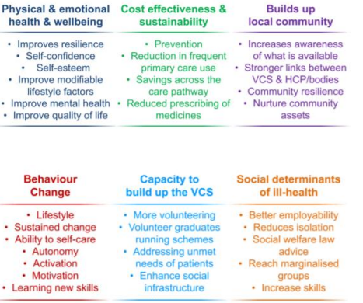

WHERE IS SOCIAL PRESCRIBING HAPPENING? [klo2]
While the term “social prescribing” has come to prominence over recent years, the actual concept has been actively operating helping the “hard to reach or seldom heard” who for many reasons: fear, poverty, stigma or simply a lack of knowledge, have failed to access health care provision.
The model below brings together key inter-related elements and illustrates the reasoning behind social prescribing:

Slide 20
Useful Resources
The Social Prescribing Network
https://www.socialprescribingnetwork.com/resources/useful-websites
What is the evidence on the role of the arts in improving health and well-being in the WHO European Region?
https://gallery.mailchimp.com/a694bc0ff11d9dd94b05ccd0d/files/900a6411-424d-4617-8d31-9a6aadcf2b03/WHO_2pp_Arts_Factsheet_v6a.pdf
Debs Taylor: Expert by experience & Peer Support Officer for Creative Minds
“The Impact of Social Prescribing on People & Communities”
https://www.youtube.com/watch?v=GT35aDMbTAI
Videos
& websites

Slide 21
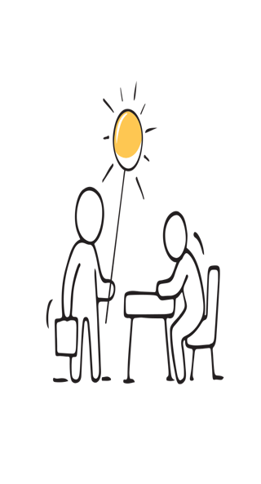
WHY IS SOCIAL PRESCRIBING COMING TO
THE FORE OF PERSON-CENTRED CARE? [klo3]
Examples of support
Support is as varied as the individuals who
need it. Everything from groups of friends meeting for a chat, peer support groups
and online communities, clubs and informal
hobby or activity groups, to sports, arts and culture organisations, as well as more charity services such as information, advice and advocacy.
Examples include home visits, befriending, accompanying to appointments and encouraging new skills and activities. These
include arts/ crafts/healthy eating/ exercise/ dancing/ baking/ creativity projects/ gardening/book club/ IT classes. Support with daily living tasks such as shopping, housing, transport, accessing help with financial matters, filing in forms and practical activities.
Signposting to other sources of support such as housing, addictions services, and mental health resources. All to prompt community engagement and reduce isolation and anxiety and achieve better health outcomes.

Slide 22

The ACTIVATE Compendium of Social Prescribing Community Care Projects
The Compendium details 35 examples of social prescribing projects in action across Europe- you can access this document here [insert link] and see the diversity of support that is available. It showcases European case studies of community projects which:
1) have tremendous potential in the sphere of social prescribing and/or
2) Are already having an impact on the health and wellbeing of those involved in them.
When exploring the Compendium, it is clear that while there are many positive examples of social prescribing, however it isn’t a one-size-fits-all solution. There are examples where previously depressed people have reported an alleviation of symptoms because they have become socially connected through a project or activity. Not everyone will have the same experience, and social prescribing should not be a substitute for medical advice. There is a huge variation of the types of groups and activities, and social prescriptions for these can range from non-governmental organisations (NGO’s) like those examples from Greece & Spain, community and voluntary sector groups like those in Ireland and UK, and the arts and culture and creative projects that are prevalent in France and Denmark.

Slide 23
Jennifer Neff :Ted Talk “Social Prescribing and the power of change”
https://www.youtube.com/watch?v=0lVnN_eZk8k
Pocket Medic “The Best medicine”
https://vimeopro.com/ehdm/social-prescribing/video/299877615
University of Bath “Social Prescribing Feasibility Report”
https://purehost.bath.ac.uk/ws/portalfiles/portal/426828/Brandling_SocialPrescribingFeasabilityReport.
Videos & Resources

Slide 24

Can you identify the key ingredients of a social prescribing scheme?
True/False Quiz
Clear referral criteria and communication between agencies and sectors.
Joint strategic needs assessment and partnership working
Co-produced personalised plan, tailored to individual needs at a pace appropriate to each person.
Collaborative health and wellbeing strategies.
Prevention strategies.
Sustainability planning.
Research has indicated that the link worker is the most important role in social prescribing .

Slide 25


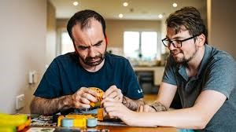
Articles you may be interested in…
The following articles illustrate
“A typical day in the life of a social prescriber”
https://www.healthysurrey.org.uk/community-health/social-prescribing/a-day-in-the-life-of-a-social-prescriber
https://suffolkfamilycarers.org/a-day-in-the-life-of-a-social-prescriber/

Slide 26

What does a social prescribing link worker do for the service-user?
Direct
Empathise
Motivate
Advise
Listen
Guide
Engage
Empower
Signpost

Slide 27

How to be an effective social prescriber [klo4]
Services Available
In your position as a Health & Care professional you will be very aware of the services available within your own healthcare setting, the social prescribing models asks you to step outside your role and look to the other opportunities which are available within your locality. There will be non-governmental organisations (NGO’s), community and voluntary services and directories. All offering step down menus like physical activities,
nutritional programmes, self care guidance, many of which will be of benefit to your patients/service users.
To get you started on this journey you can check out the following websites for more information:
Collaborating to support social prescribing around the world;
https://www.socialprescribingnetwork.com
Healthy Living Centre Alliance
www.hlcalliance.org

Slide 28
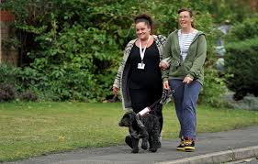
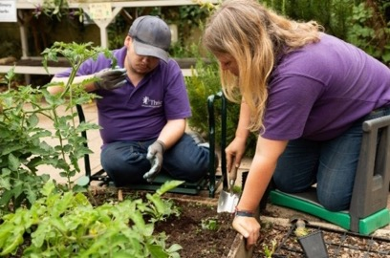
A Case Study- DARN [klo4]
A new behavioural programme
An example of a new psychological initiative called Darn which outlines a new behavioural programme in developing coping mechanisms and shifting mindsets to ‘change talk’. DARN stands for
‘Desire, Ability, Reason and Need for change’. These and other psychological measures are currently being employed in the service via the link worker. To date this initiatives have produced positive results and prompted encouraging changes for the service-users.
Link Workers Skills & Ethos
A link worker should be sensitive, non-judgemental and have integrity, flexibility and consistency.
Good interpersonal and confidentiality skills
Work as part of a team and independently
Person centred ethos
Open communication between agencies and sectors
Maintaining relationships with referring professionals
Keep accurate records/it skills/cross-referencing
Safeguarding
Identify and utilise the resources/skills/experiences of the community

Slide 29
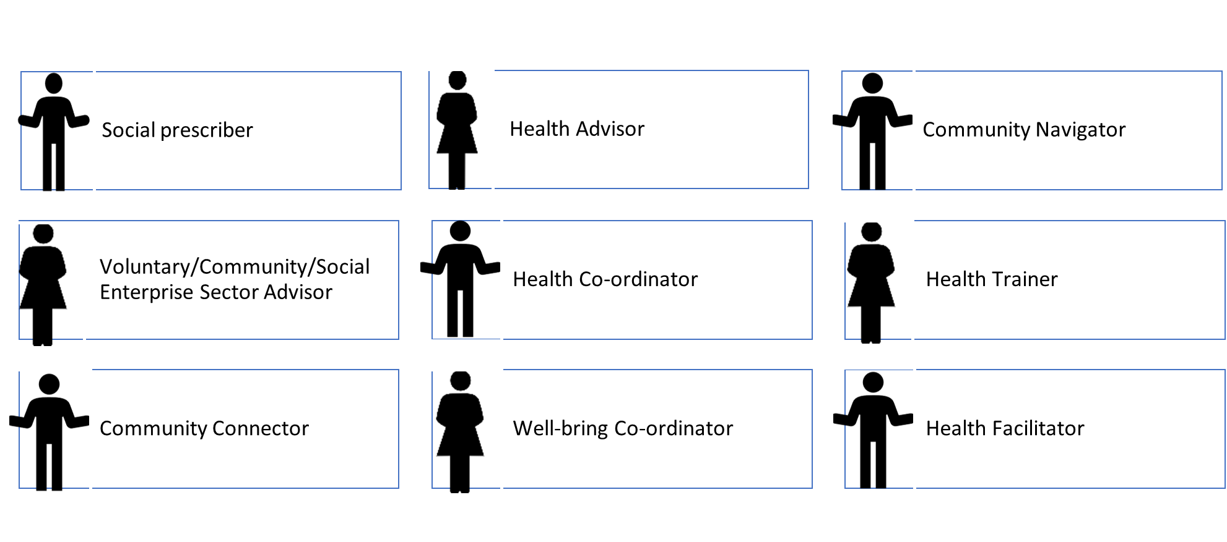
Other names used to describe a link worker in social prescribing Models [klo4]

Slide 30
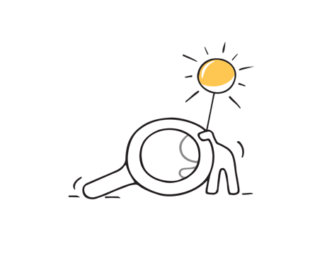
klo4] Some Questions that you might have
Question 1
Do Social Prescribing schemes actually work?
It can be difficult to measure financial savings to the health service but there is a growing body of evidence which confirms that it is a cost-saving initiative. The NHS have reported that they are experiencing reduced pressure with less GP and A & E attendances, shorter hospital stays, less complaints and reduced requests for long-term medication
Question 2
What if there aren’t any relevant groups in the area?
A link worker will see first-hand any gaps in community provision, and play a creative role in the development of setting up groups activities tailored to the person’s needs. The link worker will connect to the various hubs which host member organisations who can provide the social prescriptions. These member organisations will be drawn from the Community, Voluntary and Social enterprise sector as well as NGO’s. As referred to earlier the Compendium of Social Prescribing Community Care Projects outlines 35 European social prescribing case studies. The majority of case studies also outline suggestions for replication of their services.
.

Slide 31

plans for the future [klo5]
What is the future for social prescribing schemes?
As the social prescribing scheme develops it will be easier to identify gaps in the services and resources. The following activities will assist continued scheme development and incorporate best practice working models:
Evaluation and assessment by routinely analysing data at set points in time, e.g. routine monitoring- approximately every six months.
Open and ongoing discussions to appraise and review the agreed model, and ensure it has been a good fit with existing provision and groups in the area.
Allocating appropriate resources for impact measurement.
Assess the expectations, values and perceived aims of all stakeholders, being realistic and clear about core outcomes.
Maintaining confidentiality when linking patient records to various voluntary, community and enterprise groups and services. The data is not to be used for purposes other than internal framework and informed consent must be given.

Slide 32


plans for the future [klo5]
As research is still in the initial stages results cannot be fully proven or quantified, it does suggest that social prescribing continues to grow in scope and scale across the UK. The challenge is to deliver the concept to other areas.
However, demands during the Covid pandemic leaves the health service very stretched. In addition, the aftermath from quarantine situations suggests that there are long lasting effects on mental health.
Funding is also an ongoing challenge. Many of these organisations have long been underfunded in communities and are now under additional pressure as a result of the Covid-19 and world financial crisis.
The success of social prescribing cannot be judged purely on cost-saving or clinical outcomes, ultimately it is the primary indicator to be measured. It is fundamentally about improving the quality and wellbeing of individuals, their families and communities.
Although outcomes can be hard to quantify, longitudinal studies will, in time, evaluate it’s true impact and influence.
The Government and funding streams are crucial to its on-going success. Social Policy and strategy also will also play a key role

Slide 33


Let’s celebrate the learning [klo6]
Let’s celebrate your learning by developing your own web of care.
So now its over to you…
To embed the information and examples available throughout this topic the ACTIVATE project would like you to devise a web of care for one of your service users or your organisation.
Don’t worry there are many examples to explore in the following link to assist you in this task.
https://www.nationalvoices.org.uk/publications/our-publications/webs-care
One of the ACTIVATE partners NLDCHP also showcases its own service-user led web of care.

Slide 34

Let’s celebrate the learning [klo6]
New Lodge Duncairn Community Health Partnership
NLDCHP is a Healthy Living Centre situated in North Belfast and experience ensures that staff are aware that as people move through difficult situations with ongoing health issues and at times the need can overwhelm the availability of service to address it.
So we use the web of care template with vulnerable families to illustrate and help identify a range of support services in their locality.
Firstly you can choose a patient/service user that you have been working with or even develop a web of care for your organisation. For each web of care you will have to detail the background and context in which the model is being used. In devising the web of care for their service family NLDCHP considered:
The composition of the family members, their location and surrounding environment- transport links, shops, facilities, parks, Green spaces.
Their housing situation-social, private rented, does it meet their needs? and emerging health and social care issues. Their community and any support systems that they might have in place.
Employment status/main source of income. This background information is used to develop the web of care by exploring available community assets/ resources that the family could have already availed of alongside the more formal statutory supports.

Slide 35
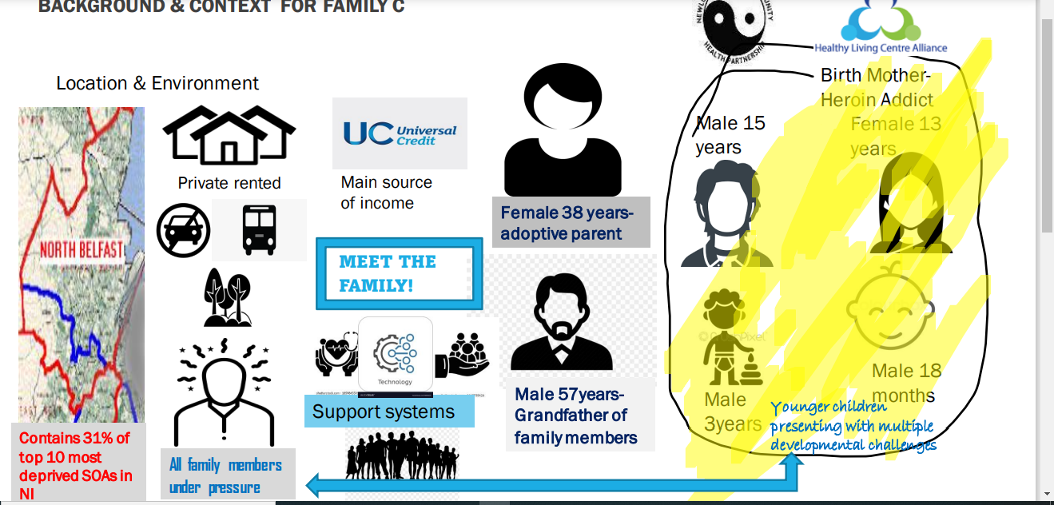
Background Information & Context

Slide 36
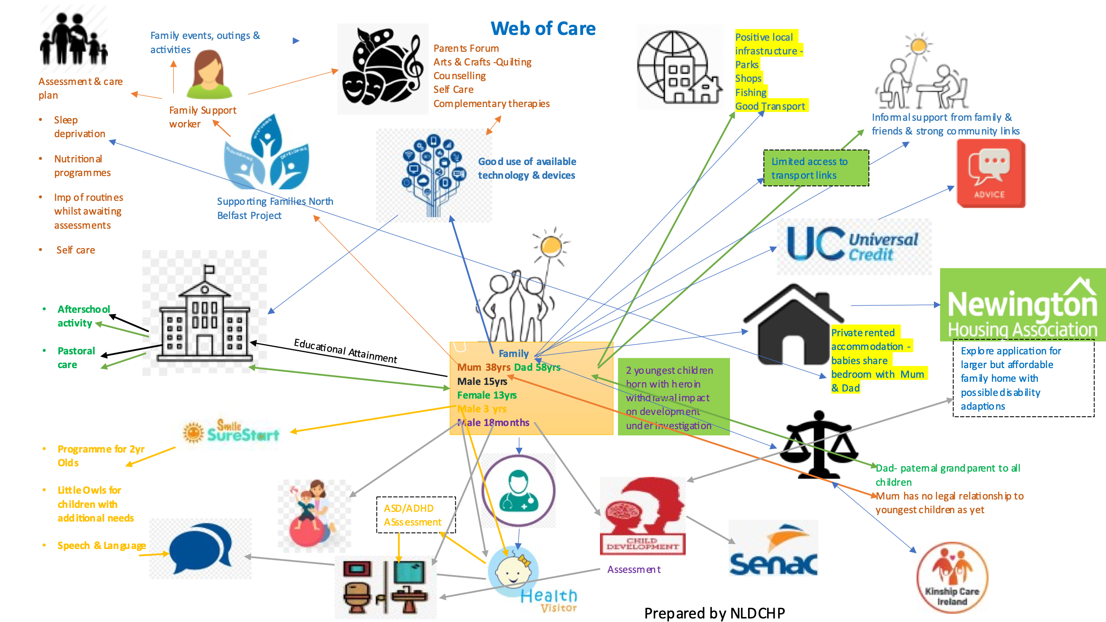
Web of care

Slide 37
Community Supports-counselling, groups & organisations
Web of care Template
Statutory supports- educational settings etc
Information Technology
Person centred care planning
Health Supports both formal & informal
Informal support- friends & family
Local Infrastructure/ Housing situation

Slide 38

Module 2
The Role of the Health & Care Professional

Slide 39
Key Learning Outcome 01
Key Learning outcome 04
Re-framing the conversation around current Health Care models
Overcoming reluctance to engage
Key Learning outcome 02
Key Learning Outcome 05
Co Design & Coproduction
Equality, Equity & Reality
Core principles of engagement for Health & Care Professionals
Key learning Outcome 03
Key Learning Outcome 06
The Stepped care model
Let’s celebrate the learning by developing A community based assets mapping tool

Slide 40
The medical support keeps me alive.
But it is the psychological and social
support that makes me live
“
Patient Blog 2019
https://q.health.org.uk/blog-post/q-visit-learning-more-about-social-prescribing-with-live-well-greenwich/

Slide 41
Re-framing the conversation [klo1]
Redefine and consider Key Questions
In Module 2 the training course for Health & Care Professionals will build on the introduction to social prescribing and the exploration of the key elements detailed in Module 1. By seeking to re-frame key elements of models already established in the health care sector, such as co-production, managing expectations and stepped models of care.
Thus providing greater understanding of holistic care pathways and preventative measures which can assist patients/services-users to manage health conditions effectively, including mental health, complex needs, and social isolation. To establish a culture of collaboration with new opportunities, in which all sectors contribute, to generate a strategic vision and objective to deliver high quality service provision.
In this module the training course for healthcare professionals will explore these issues, with the help of a narrative around key terms, with videos and case studies to further illustrate and consolidate the learning. The module will seek to answer any questions you may have:
  Why do I need to be involved?
  How do I know that the referral I make to a link worker
  will be followed up?
  How do I find out about social prescribing opportunities
  in my area?
  Can social prescribing bridge the gaps?
  The main emphasis of this module will be on making sound practical sense of social prescribing, fully acknowledging that professionals cannot be expected to have an up-to-date knowledge of local resources, but through utilising contacts with local link workers will be kept informed of what services are available in the local and wider community.

Slide 42

Re-framing the conversation
Biopsychosocial model
GPs and other professionals are familiar with the biopsychosocial model of healthcare. According to this concept interactions between people's genetic makeup (biology), mental health and personality (psychology), and sociocultural environment (social world) contribute to an individual’s experience of health or illness.
The sociocultural environment is becoming more prominent in healthcare provision, and social prescribing builds on this model using local community asset
GPs and healthcare staff can have a nonmedical referral option operating alongside existing medical treatments.
Community outlets and resources allows a further dimension to the referral pathways.
The patient is connected to community services for either the maintenance of current fitness levels, or can act as a step down intervention once a clinical intervention has ended or as a stopgap intervention during the waiting period for a clinical intervention.
Can social prescribing bridge the gaps?
https://www.cambridge.org/core/journals/primary-health-care-research-and-development/article/can-social-prescribing-provide-the-missing-link/9AEB484609AADB9EAA480D42E301700F
Making sense of social prescribing
https://westminsterresearch.westminster.ac.uk/download/f3cf4b949511304f762bdec137844251031072697ae511a462eac9150d6ba8e0/1340196/Making-sense-of-social-prescribing%202017.pdf

Slide 43
Co-design & Co –production [klo2]
In this next section we will explore more fully the key concepts already in action within health and care professional settings and add the further dimension that enables effective and impactful social prescribing.
The following definition summarises these concepts in a practical manner:
“Co-design is an attempt to define a problem and then define a solution; co-production is the attempt to implement the proposed solution; co-creation is the process by which people do both.”
https://www.stakeholderdesign.com/co-production-versus-co-design-what-is-the-difference/#:~:text=Co%2Ddesign%20is%20an%20attempt,by%20which%20people%20do%20both
The concepts of co-design and co-production are central to social prescribing and are very familiar concepts to health and care professionals in their everyday work. In the course introduction we alluded to and provided some background information to these concepts which we will revisit here and seek to advance understanding of co-production which is mutually beneficial to patients, health and care professionals alongside community and voluntary organisations and NGO partners. This additional support layer incorporates social prescribing in healthcare provision.

Slide 44
Co-design
Co-production
Is the process through which to define a problem and thereby a solution
Is the process through which to implement the proposed solution
02
03
01
04
Re framing the concepts
Co-creation
Is the process through which people do both
Using a health inequality lens

Slide 45
“Co-production is about combining our mutual strengths and capacities so that we can work with one another on an equal basis to achieve positive change.”
http://www.coproductionscotland.org.uk/about/what-is-co-production/

Slide 46
Co-design & Co -production
Health & Care professionals working in the UK & Ireland will be familiar with the various Department of Health Guides to Co-production detailed as follows:
https://www.health-ni.gov.uk/publications/co-production-guide-northern-ireland-connecting-and-realising-value-through-people
https://www.govint.org/fileadmin/user_upload/publications/Co-Production_of_Health_and_Wellbeing_in_Scotland.pdf
https://www.england.nhs.uk/get-involved/resources/co-production-resources/
http://www.1000livesplus.wales.nhs.uk/sitesplus/documents/1011/T4I%20%288%29%20Co-production.pdf
https://www.hse.ie/eng/services/list/4/mental-health-services/advancingrecoveryireland/national-framework-for-recovery-in-mental-health/co-production-in-practice-guidance-document-2018-to-2020.pdf

Slide 47

Co-design & Co -production
Previous experiences and the Covid 19 pandemic has exposed the continuing failure of traditional approaches to meet increasing levels of health needs. Conventionally, the underlying causes of ill health are not addressed holistically, such as the inequality issues of poor housing; poverty, educational attainment and poor opportunities. With the result people often feel disempowered and there is a disregard for their own experiences and knowledge in the delivery of health systems provided by councils, health service or education.
This imbalance in power needs to be addressed as part of the global development of Integrated Care Systems. Co-production is an important part of positively embedding that process as it combines the best of public services alongside communities. This process reasserts a fresh commitment to the social model of health care. In aligning the assets and skills of services-users with the appropriate allocation of resources at all levels.
Community led examples and discussions on co-production as follows
https://www.cdhn.org/sites/default/files/FACTSHEETS%2018%20Co-Production%202017.pdf
https://www.scie.org.uk/publications/guides/guide51/what-is-coproduction/principles-of-coproduction.asp

Slide 48

Equality, Equity & Reality
To have a conversation about co-production it is necessary to address the elephant in the room- equality. Research has demonstrated that Covid 19 has most severely impacted the more vulnerable members of our communities. There is no clinical definition of what constitutes a vulnerable group, the following categories outline a broad framework of classification:
Financial circumstance
Place of residence
Cultural background/ ethnicity/ history
Age
Health conditions- terminal conditions; mental illness as well as functional status and disability
https://journals.sagepub.com/doi/abs/10.1177/0009922820973018?journalCode=cpja
Issues around equality regarding access to services or resources, is underpinned by a person’s ability to pursue the support they need, and that those with limited health literacy are often unable to access the information they need. This inability to access services opens the equality v’s equity debate.

Slide 49
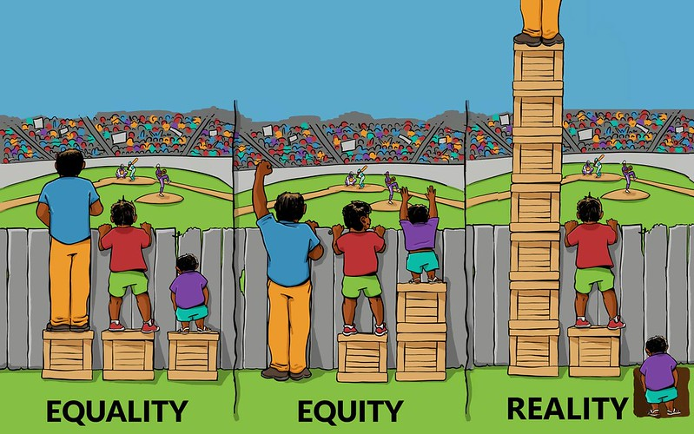
Equality, Equity & Reality https://interactioninstitute.org/equality-equality-cartoon-gallery/
Equality – Assumption is that everyone benefits from the same supports, this is considered to be equal treatment

Slide 50


Equality, Equity & Reality
Equality –
Assumption is that everyone benefits from the same supports, this is considered to be equal treatment.
Equity –
Everyone gets the support they need which produces equity
The Reality…
Reality-
One gets more than is needed, whilst the other gets less than is needed, thus a huge disparity is created.

Slide 51
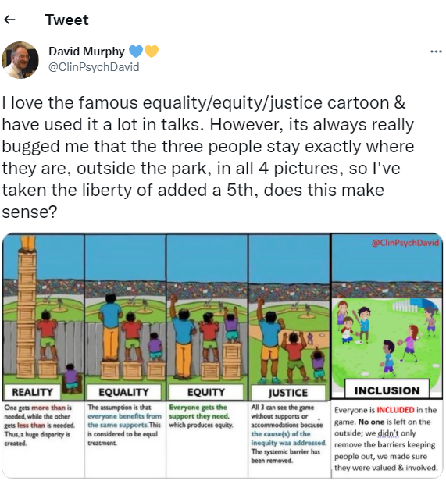
Equality, Equity & Reality
Should we be satisfied that this goes far enough?
Professor David Murphy, clinical psychologist, thinks otherwise as you will see from his twitter account.
https://www.plymouth.ac.uk/staff/david-murphy
Justice: All 3 can see the game without supports or accommodations because the cause of the inequity was addressed- the systemic barrier has been removed.
Inclusion: Everyone is INCLUDED in the game, no one is left on the outside, we didn’t only remove the barriers keeping the people out, we made sure they were valued and involved

Slide 52
Equality, Equity & Reality
Community and voluntary organisations as well as NGO’s have a long legacy of reaching those who are hard to reach or seldom heard, and that is why social prescribing can play such a vital and effective role in community health in the 21st Century. For professionals these will not be new concepts, but this course aims to re-frame the opportunities and possibilities that are available outside your health care setting.
This potential will improve the outcomes for your patients/service-users via the provision of community health programmes which whilst addressing health issues, will also connect people to the wider community thereby reducing social isolation.
Integrated care systems are developing globally, although barriers remain in relation to governance and accountability arrangements, added to the roles and responsibilities at all levels, and the financial agendas required to bring it all together. Moving forward it is a work in progress and the roles and responsibilities will evolve and progress with experience.

Slide 53
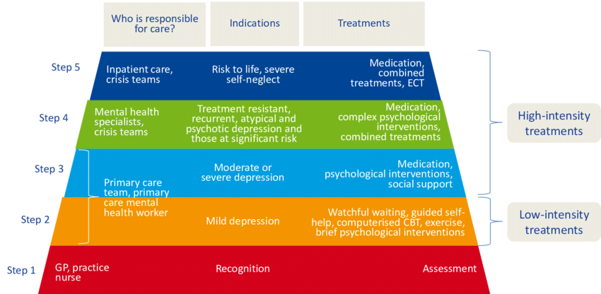
Stepped models of care [klo3]
The value of community-based services can be found in their ability to provide Tier 1/2 support services until clinical supports are available. This stepped model of care was first proposed in Northern Ireland as part of the Bamford Review [as advocated by the National Institute for Health & Care Excellence (NICE)] The Bamford Action Plan 2009-11 would provide the framework for all future delivery of mental health services with the number and nature of steps varying to address need.
This diagram illustrates the model within a clinical setting
https://www.researchgate.net/publication/302519689_MODEL_FOR_THE_ORGANIZATION_AND_REIMBURSEMENT_OF_PSYCHOLOGICAL_AND_ORTHO_PEDAGOGICAL_CARE_IN_BELGIUM

Slide 54
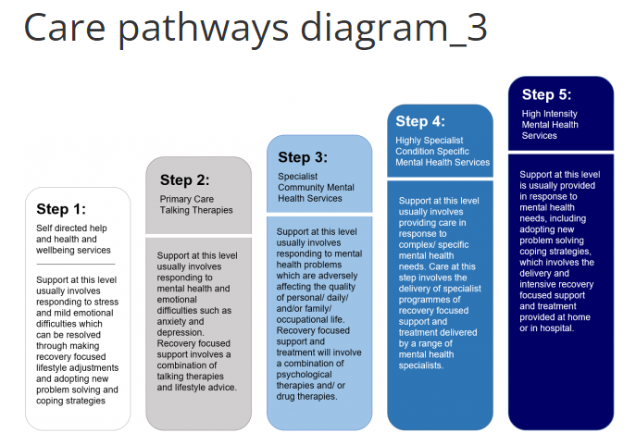
Stepped models of care
Stepped care is an evidence-based, staged approach to the delivery of mental health services, comprising a hierarchy of interventions—from the least to the most intensive—matched to the individual's needs.
It is about ensuring that people can access the most appropriate services for their mental health needs at any given time— including the ability to step up and step down to different levels of care as they move along their recovery journey.
The Bamford Action Plan highlight the steps from awareness, recognition and assessment/ diagnosis, within primary care at Step 1, through to the highest steps of inpatient or intensive treatment programmes.
The model illustrated is currently in use by the NI Assembly.
https://www.assemblyresearchmatters.org/2017/03/21/mental-health-and-illness-in-northern-ireland-2-service-provision-care-pathways-recovery-focus/care-pathways-diagram_3/

Slide 55

Overcoming reluctance to engage [KLO4]
Motivation to engage
Despite the health benefits, resource implications, cost-effectiveness, and health policy emphasis on preventive measures, there still appears to be a reluctance to fully engage in the social prescribing process. Several factors may prevent participation, these include fear/anxiety about change, a sense of ambivalence/ uncertainty/apprehension of trying new initiatives. Some would argue that it is the doctor’s responsibility to sort out their needs and as a patient they should follow only the doctor’s instructions. Others state that it is difficult to find the motivation or confidence to engage with a link worker or a social group /activity, particularly for those who are depressed or suffer from anxiety.
Other research has suggested that some health professionals can be resistant to changes and prefer the traditional methods of care. Some are uneasy with information-sharing with link workers and with other agencies, also some patients may unrealistic expectations of social prescribing as a cure-all, and consequently exasperate their conditions or mental health. Also, a lack of understanding may lead to inappropriate referrals to the wrong target group. In this instance it could result in additional time and staff hours causing further costs and delays.
Further reading: Non-clinical community interventions: a systematised review of social prescribing schemes. https://www.tandfonline.com/doi/full/10.1080/17533015.2017.1334002

Slide 56
Overcoming reluctance to engage [KLO4]
Healthcare staff and participant engagement.
The ACTIVATE resources support health professionals and patients in overcoming and changing these attitudes, address barriers to engagement, enabling patients to play an active part in their care, and facilitate conversations to identify the concerns which they would like to work on.
Social prescribing requires time, patience, open communication, commitment, and trust to engender a collaborative relationship with the link worker and engagement in community activities. It requires a motivational and person-centred approach and clear and respectful information- sharing.
The link worker will identify factors that may be affecting a service users health and wellbeing, and help to encourage and empower them to make positive behavioural changes, reassure and promote self-management, develop coping strategies and a positive sense of well-being.

Slide 57
The link worker is the critical dimension in providing open communication, befriending and signposting.
Face to Face Support
Zoom/Video calling/Virtual chat group
Referrals come from GPs, local authorities, pharmacies, multi-disciplinary teams, hospital discharge teams, allied health professionals, fire service, police, job centres, social care services, housing associations and voluntary and community associations.
01
02
This tailor-made, nonclinical approach gives patients more time to focus on what matters to them and prioritise their needs. Support plans can change according to the changing needs of the service-user, there are follow-ups where health care professionals liaise with the link worker, this is to the benefit of all concerned.
Telephone Support
03
Information & support for social prescribing can be provided by telephone or online, and information materials can be found in all healthcare locations, libraries, post-offices, and community settings.
Home visits/cafes/walking /shopping
04
The advantage of meeting in non- clinical settings is that the link worker can give the patient time, focus and empathy, so that they can feel heard and understood, working collaboratively in shared decision making, support planning and personalised care.
Activities and appointments in the community
05
these include-classes/ clubs/ cookery/ gardening/ chess/ IT/ creative arts/support groups/ talking therapy/workshops/ social groups/ leisure centres/libraries/cinema/coffee mornings.

Slide 58
Results have been encouraging [KLO4]
Overall the feedback on social prescribing has been positive. The aim to support long-term behavioural change and better self-care have has had promising results. Research has shown a significant improvement in service-user’s quality of life and general wellbeing and allows patients to take greater control over their lives.
Furthermore, there is a reported decrease in levels of depression, anxiety, and loneliness among those who engaged in the process, as you will see from the previous slide the role of the link worker is critical. It also addresses wider implications as it contributes towards overcoming social inequalities by addressing mental, psychosocial, and socioeconomic issues. Encouraging findings have revealed a reduction in healthcare costs, with the added benefit of easing the growing pressure on general practice clinics, A&E attendances and in secondary care referrals.
These are very quite inspiring developments considering the current times and how the Covid 19 pandemic has impacted the Health Service. Information is available online, and there are many information leaflets in all healthcare locations, libraries, post-offices, and community settings.

Slide 59
Case Study: Meet Josephine -56 years old
Mental Health Status
Physical Health status
Regularly attends GP surgery with mental health issues, headaches, and stomach issues. She is taking quite heavy medication for anxiety and feeling very low due to her mental and physical health
Is overweight, eats unhealthily and rarely takes exercise.
02
03
Home life
01
Lives with partner, but relationship strained. Josephine is unemployed due to ill health and reliant on benefits, but her partner works.
04
Current Status
Experiencing anxiety due to conflict with wider family circle and with her partner.

Slide 60
STEP
STEP
STEP
STEP
01
02
03
04
GP Review
GP /Patient
GP Referral
Social Prescription
GP has noticed that Josephine regularly attends the surgery for the same problems.
GP asks Josephine if she would consider support with her health and wellbeing.
Josephine agrees that it is time to make changes and consents to a referral.
Josephine meets her link worker Melanie within the agreed timeframe of 4-6 weeks.

Slide 61
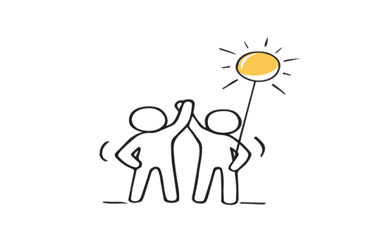

Social Prescribing Case Study
Melanie offers appointments lasting 60-90 minutes long; this gives Josephine plenty of time to discuss her problems and issues. Josephine chooses the venue, and this can vary with each appointment. This relationship takes time to grow, and a rapport is developed, consequently there may be several appointments before the support plan (action plan) is completed.
During the appointments Josephine and Melanie discuss:
Josephine often feels low and doesn’t know what else to do other than see the GP.
She feels socially isolated, and sometimes overwhelmed by her feelings.
Her partner works and she often feels resentful that she is on her own most of the day.
Would like to eat healthier and become more active, her weight gain is making her depressed and self-conscious about going out.
She has sleep problems.
She has fallen out with some of her family, and this adds to her feelings of isolation.

Slide 62
Social Prescribing Support/Action Plan
Support Plan
Melanie guides Josephine through the wellbeing tools and together they create a wellbeing action plan that Josephine can apply when she is starting to feel low, this helps her to feel more in control of her mental health and less dependent on the GP.
Look at community groups and hobbies that Josephine is interested in, so that she can build a social network and reduce her social isolation.
Reassess benefit entitlement and refer Josephine to Independent Advice Agency for financial advice.
Work with the Healthy Options advisor within the practice for support with new lifestyle factors and becoming healthier and happier, and to reduce reliance on the GP and medication.
What services, groups and activities was Josephine supported to access?
Membership of local leisure centre, she now attends weekly women’s sessions in the swimming pool.
Talking Therapy: with community based counselling service
Mental Health Peer Support Group meeting monthly in local hotel- facilitated by Regional Voluntary Organisation
A local book club and she has became a member of the library, and uses the laptops and IT resources available.

Slide 63

Social Prescribing Support Plan Review
Josephine continues to link in with Melanie, she is exercising more, learning new skills, and has met new people at the leisure centre and through the book club. She is considering a medication review with her GP, to consider a decrease in her medication intake. She attends a support group with a regional voluntary organisation and on an one-to-one sessions with a community-based counselling service. Overall, her relationships have improved, and she is sleeping better and has become a healthier and happier version of herself.
Social prescribing support can adapt according to situational changes and events, for some there may be periods of relapsing into unhealthy habits, but the personalised continuity of care from the link worker, alongside the learned strategies enable the service-user to maintain healthy lifestyle choices and reap its benefits. Support plans can change accordingly, there are regular follow-ups with health care professionals who can liaise with the link worker, this chain of communication is to the benefit of all concerned.
For similar perspectives please explore the following link:
Co-Design and Co-Delivery: The Benefits of Integration From the Family Caregiver’s Perspective (ijic.org)

Slide 64



Does Social prescribing fit in with wider health and care policy? [klo 5]
The research to date suggests that social prescribing has led to improved quality of life and enhanced emotional wellbeing. However, as stated, evaluation can be hard to measure and may require a longer-term approach. The NHS Long Term Plan 2019 stated that partnerships between the NHS and the voluntary and community sector is integral to effective health and care.
The policy support for social prescribing must be accompanied by adequate funding for those organisations, receiving social referrals if it is to be sustainable in the long term.
The successful roll-out of social prescribing and its impact will depend on the scale, vitality, and sustainability of the voluntary and community sector, particularly in smaller based charities which may be badly affected by the current pandemic situation.

Slide 65
Does Social prescribing fit in with wider health and care policy? [klo 5]
How can you promote social prescribing in your role as:
GP: https://www.youtube.com/watch?v=Zr1yKowQlcg
Allied Health Professional- Occupational Therapist; Physiotherapist; District Nursing; Midwifery; Community Psychiatric Nurse; Dietetics; Speech & Language, care worker.
Core principles for health & care professionals
https://www.gov.uk/government/publications/social-prescribing-applying-all-our-health/social-prescribing-applying-all-our-health#promoting-social-prescribing-in-your-professional-practice
Social prescribing models | Public Health | Royal College of Nursing (rcn.org.uk)
Joyce Pickering Nurse led SP example
https://www.rcn.org.uk/clinical-topics/public-health/self-care/social-prescribing
https://bmchealthservres.biomedcentral.com/articles/10.1186/s12913-018-3437-7

Slide 66

Does Social prescribing fit in with wider health and care policy? [klo 5]
As population health comes to the fore in the development of an Integrated Care System in Northern Ireland, it’s clear that collaborative partnerships between organisations and individuals who share responsibility for planning, managing, and delivering sustainable care, services and interventions. This is to meet the health & wellbeing needs of local populations. This shift to outcomes-based population health will enable examination of:
Conditions management
Early detection
Risk factors
Wider determinants of health
It should be noted that the finance regime that manages undertakings and programmes must be effective and responsive to these new pathways, and this takes time. In this way, it is hoped that Northern Ireland will begin to make best use of the available assets and resources. The “No More Silos” Report will collectively start to make a difference for population health and facilitate more resilient communities.
https://online.hscni.net/our-work/no-more-silos/

Slide 67
innovation
goal
Development of alternative information sources: Pharmacies; GP’s; dentists before attending A & E
Social Media will only reach those who use those forms of social media-
Explore alternative ways of reaching service users including younger people
Integrated Care System implementation across Northern Ireland
goal
empowerment
empowerment
management
Health inequalities: some service users/carers may not have the time, energy the educational attainment to participate.
Bring the conversation to them as their voice will be critical in enabling and embedding change.
innovation
leadership
leadership
Which demonstrates the ability to flex:
Services change in response to circumstances
Budgets which can adapt to change planning
creative
management
creative
Investment in strong leadership and collaborative working practices
Support & training to enable patient/care/VCSE participation in health structure development
Digital solutions to underpin patient records accessibility which are cognisant of transparency and security
Impact measurement & accountability

Slide 68
Let’s celebrate the learning Part 2 [klo6]
Let’s celebrate your learning by developing a community based assets map.
So now its over to you…
To embed the information and examples available throughout this topic the ACTIVATE project would like you to devise a community based assets map for one of your service users or your organisation, there are many examples to explore in the website link below to assist you in this task.
https://elevateni.org/resources/asset-mapping/
One of the ACTIVATE partners NLDCHP also showcases its community-based assets map

Slide 69
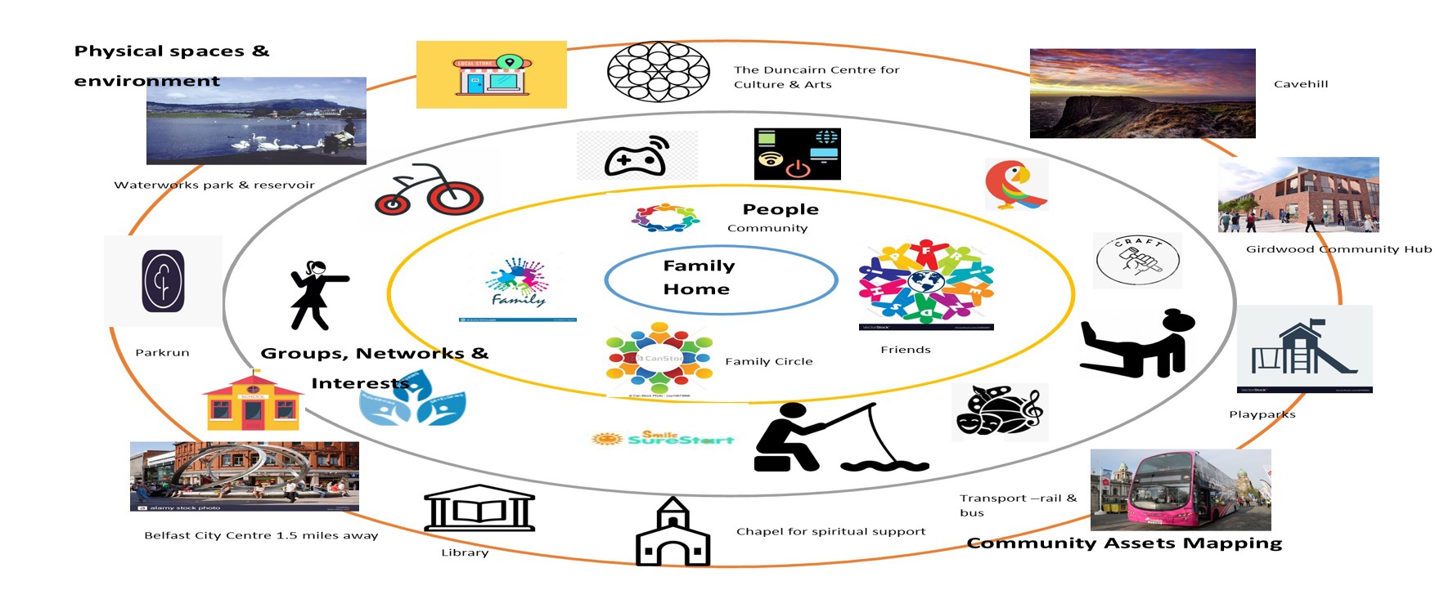
Community Based Assets Mapping [klo 6]

Slide 70
Community Based Assets Mapping [klo 6]
PHYSICAL SPACES & ENVIRONMENT
CLICK TO TYPE
CLICK TO TYPE
PEOPLE
FAMILY HOME
CLICK TO TYPE
CLICK TO TYPE
GROUPS NETWORKS /& INTERESTS
CLICK TO TYPE
COMMUNITY ASSETS MAPPING

Slide 71
Social prescribing IN action
Topic 3 Module 3

Slide 72
CONTENTS
1
2
3
4
Introduction to social prescribing in action
Exploration to date from Modules 1 & 2
European social prescribing in action
Social Prescribing within a healthcare context
5
6
7
8
Co-Production exemplars
Social prescribing ethos exemplars
Stepped care models
conclusions

Slide 73
STEP 04
STEP 01
Activate Project is the 1st Adult Education Project dedicated to social prescribing.
ACTIVATE project will showcase a range of social prescribing in action examples from across our partner regions.
STEP 02
STEP 05
Bringing sustainable development goals into focus.
Formal & informal SP models., exploring a range of large to small scale exemplars.
STEP 03
STEP 06
Seeking to improve health literacy for the most vulnerable members of communities.
Focus on multi- disciplinary teams, models of co-production & person-centered care.

Slide 74


Introduction to Social Prescribing In Action
As Europe begins to emerge gradually from Covid 19, the well-being cost on the population is yet to be determined. Huge and overwhelming issues envelop our communities, sudden unemployment, weakened social institutions and eroded social capital. Mental health support services are preparing for an unprecedented spike in demand.
A study in The Lancet confirms that the loss of liberty, fear of infection and length of separation created an environment that often brought about post-traumatic stress, detachment, insomnia and anger: “the psychological impact of quarantine is wide-ranging, substantial, and can be long-lasting.”

Slide 75
Exploration to date has found that:
Social Prescribing is a powerful, proven community mechanism. Designed to improve the physical, emotional, mental wellbeing of adults by connecting them to non-medical community-based sources of supports.
Social prescribing models use a bio-psychological-social approach. The key ethos of social prescribing is to provide support to enable individuals to take greater control of their own health.
Despite this understanding and that the benefits of social prescribing are vast and the process relatively simple, social prescribing is still a relatively unknown community approach to embedding life-long learning as a resource for living.
The ACTIVATE partnership prescribing is multifaceted, dependant on the systems in each country.
ACTIVATE
partners
are;
UK
Ireland
France
Greece
Spain
Denmark
A

Slide 76






Social Vegetable Garden for oncology patients
https://www.iglesiasanlorenzoubeda.com/fundacion-huerta-de-san-antonio/
In Good Age : https://www.youtube.com/watch?v=cabSlu4UB_g
Open classrooms for seniors https://www.upo.es/aula-mayores
Fundación TAS https://www.fundaciontas.org
Social Prescribing In Action
Spring social prescribing www.springsp.org
Radius Floating Support www.RaduiusHousing.org/
CLARE CIC Http://clare-cic.org/
GROW http://grow-ni.org/
UK
Spain
Tidy Towns https://tidytowns.ie/
Ros Sports Partnership www.rosactive.ie/
Laughter yoga Ireland www.laughteryogaireland.org/
The Seany Project www.theseanyproject.com/
CINTER- Intergenerational Reference Centre
https://www.centrointergeneracionaldereferencia.com/
CONNECT YOUR CITY http://www.connectathens.gr
Intervention in the Community for socially isolated, older & disabled people
https://www.iasismed.eu/?lang=e
Ireland
Greece
Re sante vous www.resantevous.fr Nous Viellions Ensemble - we will grow old together
https://culture-sante-aquitaine.com/le-laboratoire/nos-projets/nous-vieillirons-ensemble/
Tell me what you are listening to
https://culture-sante-aquitaine.com/dis-moi-cque-tecoutes/
Open water winter swimming https://www.badesikkerhed.dk/en/adults/winter-bathing/
Culture Vitamins https://www.weforum.org/agenda/2019/08/mental-health-depression-denmark-kulturvitaminer/
France
Denmark
European wide Change of View https://change-of-view.eu/

Slide 77
Social Prescribing within Healthcare Contexts
In some of the partner regions social prescribing is actively embedded into health practice and policies, since 2019 the UK through its Long Term Plan and the Universal Personalised Care Plan, has endorsed social prescribing (SP) as a key component, “taking a holistic approach to people’s health and wellbeing”.
[ https://www.longtermplan.nhs.uk/ ]
In Ireland social prescribing structures and mechanisms are progressing, like the All Ireland Social Prescribing Network to embrace and embed the SP concept moving forward.
[ https://allirelandsocialprescribing.ie/ ]

Slide 78
Acknowledged as 1 of happiest places to live for 9 years.
Heightened awareness of mental health- free healthcare through high taxation system.
https://borgenproject.org/mental-health-in-denmark
2016 OECD study called for further progress to:
Promote appropriateness of care
Prevent spread of risk factors
Address geographic variations in healthcare
Development of community base services
[https://www.oecd.org/france/Health-Policy-in-France-January-2016.pdf ]
France
Denmark
Greece
Geographical health Situations
Across Europe
United Kingdom
2019 UK through Long Term Plan and Personalized Care Plan has endorsed Social Prescribing.
https://www.longtermplan.nhs.uk
Financial crisis has had significant impact on health & wellbeing. Limited resources have resulted in high unemployment rates, people are facing poverty..
[https://borgenproject.org/mental-health-care-in-greece/
Spain
Ireland
Social prescribing structures and mechanisms are progressing to embrace and embed the SP concept
https://allirelandsocialprescribing.ie
Non-governmental organizations are leading the way through the design and implementation of development based projects.

Slide 79





Social Prescribing within Healthcare Contexts
The previous slides illustrates clearly the multi-faceted development of social prescribing across the partner regions and countries, considering the health context within each and now we will consider the development of social prescribing:
UK- Fully integrated within Health care Policies and Procedures.
Ireland- Progress underway and social prescribing developing across the region.
France- Development of socially based services for mental health disorders is reflected within the social prescriptions that are available as social and cultural organisations are at the forefront to the developments.
Greece- Non- Governmental Organisations [NGO’s] are spearheading the charge for social prescribing playing a critical part in developing society, improving communities, and promoting citizen participation.
Spain- Social prescriptions are now incorporated into primary care electronic notes.
Denmark-- Social prescribing is person centred with mental health centred mass support activities.

Slide 80
Social prescribing Exemplars
The ACTIVATE project will now showcase a range of social prescribing in action from across our partner regions. These examples will demonstrate the formal and informal models in line with the development of the social prescribing concept within the region. As Health & Care Professionals you will explore a range of exemplars from large NGO interventions with many formal collaborative partners and funding streams to small community-based organisations, all supporting mental health in creative and nurturing ways.
There will be link workers and social prescribers in some settings in line with the three essential elements of social prescribing. There will also be other examples of stepped care models for those who have completed a formal clinical intervention, stepping down to a less formal self-selected but no less impactful CVS supports. You will see multi-disciplinary teams in action, with a focus on co-production with person-centred action plans.
It is hoped that as Health & Care Professionals you will discern that when lifestyle change and health behaviours are discussed that social prescribing has the potential to bridge the gap between the knowledge (awareness of health risks and advised—by healthcare professionals—lifestyle modification) and behaviour (adapting and sustaining a new lifestyle).

Slide 81
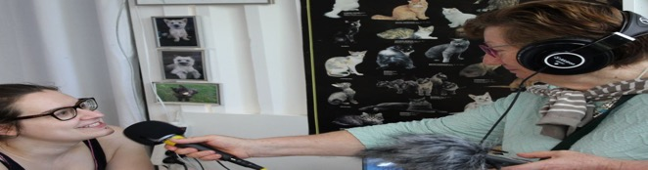
Co-production exemplar
Tell me what you are listening to
CLICK
TO VIEW
ABOUT
“Dis moi c’que t’écoutes” or, in English: “tell me what you are listening to” is based in the southwest of France. It is a project which links older people living in nursing homes with teenagers, to create interviews and podcast projects. Both the older adults and the teenagers were able to learn new skills and express themselves creatively, all while benefitting from the intercultural knowledge exchange of working together.
For more information https://culture-sante-aquitaine.com/dis-moi-cque-tecoutes/ http://www.ricochetsonore.fr/actus/365/dis-moi-cque-tecoutes-ehpad-le-petit-trianon
SUPPORTING SOCIAL INCLUSION AND CONNECTION
This project creates intergenerational connections between teenagers and adults.
SUPPORTING HEALTH, WELLBEING & NUTRITION
For many older people, it is a challenge to feel active and useful to society. This project and its intergenerational exchanges allows older adults to feel useful and
stay active, which is proven to be good for their wellbeing.
SUPPORTING ADULT LEARNING
This project supports adult learning because people were educated on the radio equipment : micro, headphones, machines.
HOW IS THE ORGANISATION FUNDED?
Through the Association du Lien Intercultural Familial et Social.
HOW DOES THE REFERRAL PROCESS WORK?
No referral needed. This project is a partnership between individuals, facilitated by schools and nursing homes.
OPPORTUNITIES FOR REPLICATION
This project was repeated several times with the same cultural partner. It could easily be replicated in any place there is the opportunity for collaboration between a school, a nursing home, and a facility with recording equipment.

Slide 82

Co production exemplar
CLICK
TO VIEW
GIVMED - Medicine Donation Service
ABOUT
GIVMED is based in Athens, Greece. It is a non-profit organization aiming at facilitating access to medicines for all. People can easily and quickly donate the medicines they no longer need to social pharmacies, nursing homes and other public benefit entities. They are provided to people who need them but cannot access them otherwise; – groups like the poor, the elderly, refugees and others with limited or no access to medicines.
For more information go to https://givmed.org/en/
SUPPORTING ADULT LEARNING
The objective of the project is the information about the right to health, the improvement of medicine literacy and the compliance with treatment. GIVMED’s part as the implementing body is the project’s administration and carrying out of informational and empowerment methods. The part of the Institute of Social and Preventive Medicine, as a partner, involves developing the informational and educational material and participating at the healthcare professionals training.
SUPPORTING HEALTH, WELLBEING & NUTRITION
This project helps vulnerable people access essential medication. The aim of the project is to empower socially vulnerable groups on by:
Informing them of their rights regarding healthcare.
Providing education in terms of handling medicines and medication compliance.
Facilitating their access to the medicines they need through a specific application for smartphones.
HOW IS THE ORGANISATION FUNDED? Click to type.
HOW DOES THE REFERRAL PROCESS WORK?
The program MEDforNGOs, is directed to charitable bodies. Through the homonymous specific its software which has been developed by GIVMED, the public benefit purpose entities who register their medication surplus which they can donate. The information is automatically spread to all the charitable bodies of our network and GIVMED coordinates the whole donation process.
OPPORTUNITIES FOR REPLICATION
Organizations could work with pharmacies and hospitals to know their drug needs. Places will be created where the medicines will be collected and according to their needs will be shared out accordingly.

Slide 83

Social prescribing link worker exemplar
CLICK
TO VIEW
Roscommon Sports Partnership
ABOUT
Roscommon Sports Partnership was established in 2002. 29 Local Sports Partnerships form part of a national structure to co-ordinate the development of sport and physical activity at a local level. Their wide range of actions work with the aim of increasing sport and physical activity participation levels in their local communities.
Please visit; https://www.rosactive.org/
SUPPORTING SOCIAL INCLUSION AND CONNECTION
Joining a sports team, cycling or walking group supports people in making friends, connecting with people and socialising. It supports social inclusion by targeting groups of people that experience social exclusion.
SUPPORTING HEALTH, WELLBEING & NUTRITION
It supports health and wellbeing by connecting people to clubs and activities.
SUPPORTING GETTING ACTIVE TO KEEP WELL
Roscommon Sports partnership supports getting active by connecting people with groups that do sports and physical activities in the local area.
SUPPORTING ADULT LEARNING
RSP supports adult learning by exposing adults to new sports or activities
HOW IS THE ORGANISATION FUNDED?
The organisation is government funded by Sport Ireland.
HOW DOES THE REFERRAL PROCESS WORK?
The Social Prescribing Co-ordinator links individuals with suitable local sports activities via Roscommon Sports partnership.
OPPORTUNITIES FOR REPLICATION
Sports Partnerships in Ireland are part of a national network funded by central government. SPs could be started on a smaller scale, e.g. having one in a particular town. It could also be replicated on a cheaper/ more impersonal scale by providing a place for all local sports information to be easily accessed by those in the community (e.g. digital notice board).
MYTHS
“I have a disability so I can’t get involved.”
The Sports Partnership welcomes you regardless of ability and offers some activities specifically for people with disabilities.
“I won’t be welcome because I’m from a disadvantaged background.”
We always welcome people who have been disadvantaged.

Slide 84
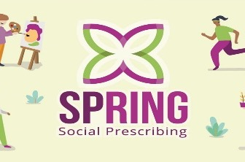
Social Prescribing exemplar
CLICK
TO VIEW
Spring Social Prescribing Project
ABOUT
Spring Social Prescribing Project in Northern Ireland and in Scotland, helping people to address their mental, emotional, practical and physical health needs by connecting them with the rest of the community. As a result of SPRING SP there has been a marked decrease in the number of GP visits, ultimately taking the pressure of NHS services..
The website: https://www.springsp.org/
SUPPORTING SOCIAL INCLUSION AND CONNECTION
SPRING support programmes are to support those suffering from social isolation, low mood, mild depression, long term conditions or physical inactivity. This includes social clubs, arts & crafts, a phone helpline, peer support groups, advice and guidance or volunteering groups. A total of 70 percent of referrals were made on behalf of people experiencing low mental health issues and social isolation and long-term conditions..
SUPPORTING HEALTH, WELLBEING & NUTRITION
SPRING helps provide support for food, heating, shopping, social isolation, health issues such as Type 2 diabetes, digital exclusion
SUPPORTING GETTING ACTIVE TO KEEP WELL
With a support worker a health support plan is designed, one that identifies things would need and would like as an individual. This may be anything from joining an exercise class, or walking, cycling, fishing groups, yoga classes, or swimming lessons.
SUPPORTING ADULT LEARNING
There are education and learning supports provided,, empowering people to make decisions about their learning opportunities, connecting them to suitable programmes and services.
HOW IS THE ORGANISATION FUNDED?
SPRING has secured funding from the National Lottery Community Fund, Northern Ireland Housing Executive and the Department for Agriculture, Environment & Rural Affairs
HOW DOES THE REFERRAL PROCESS WORK?
GPs, health professionals, pharmacists, non-statutory bodies. . https://youtu.be/UwlgfSz_CDw
OPPORTUNITIES FOR REPLICATION
Yes, these services and resources can be reproduced throughout the world.
MYTHS & FALSE BELIEFS “There is a long waiting list”.
This is not true. SPRING has a quick turnover rate and contact potential service-users as quickly as possible.
“It’s the same as counselling”.
No, it’s different. Although social prescribing, like counselling, provides a safe space to talk and explore issues, SPRING link workers are able to support people in a more practical sense, as well as providing emotional care. A link worker can help sign-post participants to specialist counselling services.

Slide 85


Social prescribing exemplar
CLICK
TO VIEW
CLARE
ABOUT
The vision of the CLARE [Creative Legal Action Responses & Engagement] is to create a community where all people feel supported and engaged, where people look out for one another and where everyone has the opportunity to reach their full potential.. It is a community led voluntary organization working within North Belfast providing person-centred support to help engage with the most vulnerable to design and implement a holistic living plan. Objectives include the reduction of early reliance on adult health & social care services. Assists timely hospital discharge and support to return home and help to prevent deterioration in health outcomes. Empowers individuals to have ownership and greater control over the care they receive. Promotes choice and control through self-directed support. Assists with practical tasks within the home and light housework. http://clare_cic.org/
SUPPORTING SOCIAL INCLUSION AND CONNECTION
Provision of Befriending service to reduce feelings of isolation and loneliness, and promotes independence by empowering individuals. Assistance to connect with existing social activities. Accompanies individuals to appointments and events.
SUPPORTING HEALTH, WELLBEING & NUTRITION
Support to access resources and services relevant to the individual’s needs such as support groups/activities to enhance physical or mental well-being. Opportunities to help with animals, walks and bowling.
SUPPORTING GETTING ACTIVE TO KEEP WELL
Connect with existing services relating to staying active and maintaining good health
SUPPORTING ADULT LEARNING
Information and sign-posting to various courses/classes available.
HOW IS THE ORGANISATION FUNDED?
Belfast Health & Social Care Trust & Dormant Accounts Fund National Lottery Community Fund, Public Health Agency NI-CLEAR & Community Foundation Northern Ireland
HOW DOES THE REFERRAL PROCESS WORK?
Works closely with Belfast Trust, Home from Hospital service and volunteer support.
OPPORTUNITIES FOR REPLICATION
There are many countries already delivering services to enhance the lives of adults and older people and to help maintain their independence and self-determination.
MYTHS & FALSE BELIEFS
“There’s no point trying anything new at my age”
“They won’t accept me because of my medical condition”
Both untrue: CLARE’s ethos is focused on ‘what a person can do and not on what they can’t’.

Slide 86




Social prescribing exemplar
CLICK
TO VIEW
Fundación TAS
ABOUT
Fundación TAS (the TAS foundation) is based in Brenes (Seville) in Spain. They provide support for people with disabilities and older adults, to participate in the workforce in a way which accommodates their disabilities and works for them. Through its Labour Insertion service, these people are individually guided in their social and work adaptation and transition to a job in a normalized company or in the Foundation's Special Employment Centre (SEC). In this SEC, the participants make a “controlled immersion” in a real work environment, where the objective is that they carry out productive and remunerated work, obviously, according to their personal characteristics.
For more information go to https://www.fundaciontas.org
SUPPORTING SOCIAL INCLUSION AND CONNECTION
Fundación TAS programs promote participation in group activities and, therefore, interaction and the creation of interpersonal bonds. For older adults and those with disabilities, sharing time with other people in occupational workshops helps towards new life goals and create new relationships. Adults of working age who, due to accident, illness, etc., have been removed from their working life, can be socially isolated and may lose confidence to reintegrate into their social life and in the job market by themselves. Fundación TAS supports these people to access a supportive and social work environment.
SUPPORTING GETTING ACTIVE TO KEEP WELL
Fundación TAS programs helps with social isolation which can lead to neglect of diet and physical condition, and develop mental health problems such as depression. Programs involve physical exercise also linked to complementary activities organized by the Foundation, through a Leisure and Personal Autonomy Program.
SUPPORTING ADULT LEARNING
Adult Learning is a fundamental part of the work carried out from this integrated set of resources for employment. Fundación TAS conducts Occupational Workshop from a pre-employment perspective and in the SEC with a direct focus on the labour market.
HOW IS THE ORGANISATION FUNDED?
Through contributions from public entities, patronage, beneficiaries, banks, micro donors (individuals and companies), brotherhoods and so on. Approximately 67% is public financing and 33% is private.
HOW DOES THE REFERRAL PROCESS WORK?
Foundation's technical staff (psychologists, therapists, etc.) refer those who potentially fit the employment criteria, coordinating its labour with different employment services.
SOCIAL PRESCRIPTION FOR PEOPLE WITH DISABILITIES THROUGH COLLABORATIVE WORK

Slide 87


Stepped Care
Exemplars
K
TO VIEW
Change of View
ABOUT
“Change of View” is based across Europe. The project is a game board intended to be used by professionals in working supportively and educationally with vulnerable populations., The game challenges vulnerable people’s internalised biases, and negative self-beliefs., it was developed by a number of European partners, and can be found on the web. Through playing the game, users get more knowledge about their own points of view and of others. The game is empowering and allows users to direct their own learning process. This social prescribing example was created for the educators and professionals working with vulnerable populations.
For more information go to https://change-of-view.eu/
https://culture-sante-aquitaine.com/le-laboratoire/nos-projets/change-of-view/
https://www.facebook.com/ChangeOfView.Erasmus/
SUPPORTING SOCIAL INCLUSION AND CONNECTION
This project allows vulnerable people to play games together online. The game facilitates inclusion because by using it, vulnerable people gain self-esteem and social skills and the confidence to be more active in society.
SUPPORTING ADULT LEARNING
It allows vulnerable adults to understand more about their own minds, and their own beliefs. Also as a digital game, it also helps develop digital skills.
HOW IS THE ORGANISATION FUNDED?
This organization is funded by ERASMUS+ and the French Red-Cross.
HOW DOES THE REFERRAL PROCESS WORK?
The game is available for free online for any professionals and the vulnerable populations they support.
OPPORTUNITIES FOR REPLICATION
This project originated from a cooperation between several European countries.
MYTHS & FALSE BELIEFS
This is a social prescription for adults only”
False- It is appropriate for all ages, including children who can also benefit.

Slide 88

Stepped care
exemplars
Culture Vitamins
CLICK
TO VIEW
ABOUT
“Kulturvitaminer” or culture vitamins (CV) is based in Aalborg, Denmark. which is run by the Aalborg local authority.. The programmme was aimed at adults who are off work due to depression, anxiety or stress-related issues. It provides a variety of activities including choir singing, guided reading, introduction to the city archives, listing to music, visiting an art museum and a theatre, and a nature hikes.
https://www.researchgate.net/publication/332276908_Culture_Vitamins_-_an_Arts_on_Prescription_project_in_Denmark and https://newscoop.com/culture-vitamins-powerful-medicine-for-mental-health/
SUPPORTING SOCIAL INCLUSION AND CONNECTION
CV has an ethos of community, belonging,, reconnecting & experiencing what their local area has to offer and immerse themselves in something meaningful and exciting, with the aim of relieving stress and boost confidence.
SUPPORTING ADULT LEARNING
Each activity offers new experiences of learning helping to relieve problems adults face in terms of their mental health. It is focused on learning and experiencing something new as an adult. These include;’ choir singing., guided tours in the city archives, genealogical research, the theatre, art museum, creative workshops, and preparation for job interviews.
SUPPORTING HEALTH, WELLBEING & NUTRITION
Research at Aalborg University reported participants felt increased self-esteem and motivation, more joy, improved social skills and relationships, and better self-care. Benefits both mentally and physically, also reporting less fatigue, more energy, and the ability to relax.
SUPPORTING GETTING ACTIVE TO KEEP WELL
Kulturvitaminer also offers guided nature walks encouraging people to get outside and be active. “These are also valuable in terms of seeing how slowly things grow, in contrast to our busy modern lives,” states Nielsen (Aalborg course leader).
HOW IS THE ORGANISATION FUNDED?
The Danish Government and The Health and Cultural Department developed the project and it is delivered and coordinated by the Centre for Mental Health,
HOW DOES THE REFERRAL PROCESS WORK?
Participants were informed and recruited by the project coordinator and researcher. Also, at the local job centre.
OPPORTUNITIES FOR REPLICATION
This can be quite easily replicated in a place that has extensive cultural activities/experience on offer such as libraries, theatres, scenic public spaces in nature. It would require the commitment of course leaders each week and collaboration with these cultural originations.

Slide 89
COnclusions
1
2
3
Social prescribing projects have different forms and structures
Social prescribing is emerging as a model for change
Social prescribing projects are in place across Europe
incorporates co-production, stepped care & person centred care models
Health & Care Professionals can explore local social prescribing opportunities
With the knowledge that Social prescribing has the potential to bridge gap between knowledge & behaviors
4
5
6

Slide 90


Social Prescribing Journey module 4
In these next slides we will explore the Social Prescribing journey of Roscommon Leader Partnership (RLP), an NGO serving County Roscommon in Ireland.

Slide 91

RLP’s Social Prescribing Journey
1
2
3
Background
Starting Point
Building the case
4
5
6
Measuring success & the benefits
Patient autonomy in their care
The future for SP in Roscommon

Slide 92

1. Background
Roscommon Leader Partnership (RLP) run the SICAP program (Social Inclusion and Community Activation Program). through this they established the need for social prescribing.
SICAP have a history working with people with mental health difficulties, socially vulnerable and older people in Roscommon.
Issues presented made the team see social prescribing as the best possible medium to address isolation, loneliness and supported those who are disconnected and those with physical and emotional difficulties. e.g. physical enduring back pain.

Slide 93

2. Starting Point
RLP started their social prescribing journey by examining national and international literature on social prescribing and best practice models, particularly in the north of Ireland and UK.
They talked to the HSE Health Promotion within Ireland’s National Health Service and got information on a project called Flourish in County Mayo. Flourish was one the first social prescribing models in Ireland.
RLP did a study visit to County Donegal where there were 6x part time Social Prescribers. County Donegal was the first region to obtain proper funding.
RLP also looked at other social prescribing models including one in County Offlay, and LAMP in James’s Hospital in Dublin.
The company became involved with the All-Ireland social prescribing network.

Slide 94
3. Building the case for SP
RLP put together a steering committee in partnership with agencies including SICAP, a therapy centre, the local citizens information service, a charity and the department for nursing and health care in The Technological University of Shannon.
They secured lottery funding and worked with the university on ethics and evaluation.
A study was undertaken using the World Health Organization wellbeing index, which is currently embedded in the model RLP uses.
A brief summary of the results as follows:
There was an improvement in overall health and wellbeing for participants who used the service.
Men and people under 40 living without a disability were more likely to use the service.
RLP developed their model, largely based on the Offlay prototype, and they applied for Healthy Ireland funding (national funding that goes to each local authority).
They developed a job description and advertised the post through the steering committee and the Irish Health Service.

Slide 95

4. MEASURING SUCCESS
“
We measure success based on the WHO Health and Wellbeing Index Scale:-
We ask the participant 5 questions at the start of their social prescribing journey and we repeat these questions after 3 months of the participant being in the activity to measure the change.
MICHAELA DEANE HUGGINS
Social Prescribing Coordinator
Roscommon Leader Partnership (RLP)
”

Slide 96

4. Benefits of Social Prescribing
Social Prescribing alleviates pressure from GP’s and other healthcare professionals from seeing a lot of patients presenting with non-medical issues such as loneliness and isolation. These professionals have reported a positive change. They can spend more time with people who have medical needs.
Some people have reported an alleviation of anxiety and depression symptoms as a result of social prescribing.
Benefits to the patient include increased socilaisation and reduced loneliness. Opportunities to learn or improve a new skill, or engage in physical activity.
It is also worth noting that some people need help with medical diagnoses before they can begin to engage with the social prescribing process.

Slide 97
5. Patient Autonomy in their own care package
The initial needs assessment meeting involves uncovering what matters to the individual, rather than making assumptions.
The individual’s aims and goals are established.
The individual is encouraged to express how the Social Prescribing Coordinator can support them in their journey, not the other way around.
The premise is giving people the tools to make their own choices regarding the activities that they want to engage in, with support from the Social Prescribing Coordinator.
It is all about the individual. The Social Prescribing Coordinator is a facilitator.

Slide 98

6. The future for Social Prescribing in Roscommon
There is a need in Roscommon to set up more activities.
RLP are identifying free venues to be used to facilitate social prescribing activities.
There is an ongoing discussion about payment for activities. Is it OK? For example Socially prescribing people to a dance school or a yoga class with an entrance fee.
RLP are going to create an activity checklist of suggestions for when people are struggling to know what they want.
There are geographical challenges in Roscommon with people who struggle to travel due to health issues, which they are looking for ways to overcome.
They are aiming to link people together with similar interests to start more groups.
RLP aim to include more underrepresented demographics. Research shows that the service in Roscommon was used mostly by men under 40 without a disability. We are seeing a different demographics nowadays due to referrals from occupational and psychiatric health professionals.

Slide 99
Topic 2
The Role of the Health & Care Professional in Adult & Community Learning

Slide 100
Topic 2: Improving your ability to deliver adult and community learning
MODULES
1
2
3
4
Role of Health and Care Professional in Adult and Community learning.
7 skills of Adult Educators
Advanced Communication Skills
Health
Literacy

Slide 101
Topic 2 Module 1
The role of the Health & Care Professional in
Adult & Community Learning

Slide 102
Module 1 : Improve understanding of the multi-functional role undertaken by Health & Care Professionals
These open educational resources are designed to upskill professionals in their role which is multi-functional as:
1) Social prescribers, who assess the needs of individual service users (either alone or in conjunction with others) and prescribes a non-medical social engagement solution.
2) Adult educators who guide their adult learners through an informal community learning process encouraging them to engage in positive, self-care social, cultural and community activities for their health and wellbeing.
The Social Prescribing Training Programme/Open Educational Resources for Health and Care Professionals is INNOVATIVE because it is the first pan-European resource to be created on this topic. Importantly, it introduces the topic from an adult learner perspective which is facilities its adoption and use for professionals. The course advances innovation as it introduces a new training topic to the professional learning of, but it also strives to improve their ability as informal adult educators delivering health and wellbeing knowledge in clinical and health environments.

Slide 103

The role of Adult Education concepts in the work of the Health & Care Professional?
The Adult Education Teacher Competencies identify the core knowledge and skills expected of any adult education teacher/trainer. However, in this course for professionals the ACTIVATE project aims to take this one step further and consider the competencies through a health & care lens which should enable their incorporation into working practice and ultimately improve outcomes for service users.
To this end it will be clear that the competencies support effective teaching opportunities and practices and enhance learner outcomes for all adult learners. Moreover, the competencies can also assist instructional leaders, professional developers, and teacher training facilities in planning professional learning for adult educators across a range of disciplines.
The Competencies are one response to the challenges and needs identified in recent surveys and reports on adult education. Not only do the competencies identify the knowledge and skills expected of any adult education teacher, but they also offer a structured approach to determining these skills that adult educators require alongside professional development activities.
It is recognized that adult educators also need specific content knowledge and skills related to teaching/training in their particular field. There are content area standards, such as those developed by the TESOL International Association, that address specific content knowledge.

Slide 104
Why is it important to introduce Adult education Concepts within Health Care settings?
It is important to remember that adult education teachers are a diverse group, who work in a variety of organisations (for example, school districts, community colleges, non-profit organizations, correctional facilities, and religious institutions) that serve an equally diverse learners’ population with many different learning needs and goals. Adult education programmes have diverse education funding sources (e.g., state, federal), geographic contexts (e.g., urban, suburban, rural), and resources. Staffing can be very different as well. For example, some programmes may have guidance counsellors, test administrators, or full-time professional development staff; others may have only one full-time administrator or teacher/trainer who is either responsible for filling all those roles or for referring adult learners to those who might assist them with these tasks normally done by someone in those roles.
Depending on the institutional requirements, adult education teachers may not have a degree or a relevant educational background in the subject they teach. They also can vary regarding job status (part-time, full-time), role (lead teacher, mentor, tutor), and experience (beginning/experienced teacher). Given these factors, by focusing on instruction and learning, the competencies are designed to support the essential role an adult education teacher plays in any context.
Sources:
https://lincs.ed.gov/publications/te/competencies.pdf

Slide 105
How can Adult education Concepts help people with their wellbeing?
Health Literacy levels
Promoting health literacy
For all citizens
Positive influence of
Adult Education
Learning increases
Self Confidence
Impact on healthcare system efficiency
Awareness of skills & Abilities
On People’s behaviors
Connects people in courses outside their homes thereby strengthening social networks.
A way of avoiding/reducing need for medication or counselling
Should be considered by practitioners as an alternative cure.
Benefits society as a whole by lowering healthcare costs, allowing settings to work more efficiently.
Research on health literacy & adult education enables best practice in health education
As low levels can lead to increased GP visits; hospitalisations; inappropriate treatments /prescriptions
Also, less likely to take preventative measures
Encourages attainment of knowledge, promotes empowerment & emotional well-being.
Leading to more fulfilled & happy lives
(Boardman, G., & Friedli, L. (2012). Recovery, public mental health and well-being).

Slide 106
Topic 2 Module 2
The Seven Skills of Adult Educators
In the following sections this will be identified and explored to deliver useful examples from everyday life

Slide 107
The 7 skills of Adult Educators
Skill 02
Skill 04
Skill 06
Skill 01
Skill 03
skill 05
Skill 07
Understanding
Flexibility
Patience
Practicality
humour
Creativity
preparation

Slide 108
✓ Understanding
THEORY: The most basic skill in the process of communication and delivery help, is our ability to listen carefully to each other (Ivey, Gluckstern & Ivey, 1996). Careful listening, according to Dimopoulou (2011, 213), demonstrated in the cultural and socially appropriate verbal and non-verbal behaviour of the listener, shows the speaker that you are really with him and that you are interested in listening to what he has to say. In addition to this therapeutic value, it is also a skills-based practice which helps to boost the self-confidence and self-esteem of the speaker. Listening carefully according to Ivey, Gluckstern and Ivey (1996) which consists of four dimensions:
1. Eye contact: the focus of the gaze on the person speaking.
2. Body language: which communicates to the other that we are ready to listen to him.
3. The vocal style: the tone, the rhythm, the tone, and the volume of our voice indicates whether we really listen to the speaker.
4. The verbal sequence: the ability to stick to the subject, without interruption or worrying about answers.
PRACTICE: The process of listening is understanding what the teacher/ trainer has heard. Comprehension “addresses the ability to decode a message, giving it proper meaning” (Verderber, 1998, 202). Active listening requires a verbal, usually oral interaction with the speaker based on careful monitoring of what the person says and expresses through non-verbal communication. The active listening activity allows the teacher/trainer to paraphrase the information to ensure clarity and understanding and placates the emotional needs of the speaker. The teacher/ trainer does not diminish the feelings nor make judgement based on what is said, there is a clear acceptance of the statement/conversation.
IMPACT :Impact measurement can be carried out with a worksheet-questionnaire at the end of a unit/activity, with open-ended or closed-ended questions, written by the educator and covers the themes it chooses to evaluate. Additionally, the educators must introduce a reflective diary to be completed by course trainees indicating their learning, their difficulties, their self-assessment, and the continuous communication through this with the teacher. So, hard copy and online materials are required in order to develop a climate of understanding amongst all participants, those with or those without mental health issues.
Source: (http://www.moec.gov.cy/aethee/synedria/2014_teliko/2014_06_26_handbook_greek.pdf)

Slide 109
✓ Flexibility
THEORY: Cognitive flexibility is a concept of mental health promotion. Cognitive flexibility is defined as “the awareness that in any situation there are options and alternatives available, the willingness to be flexible and adapt to situations, and the competence to be flexible (Kim & Omizo, 2006,), and it is positioned to be associated with positive mental health.
PRACTICE: The trainer creates a story, which reflects the situation for analysis. Positions and the content of the roles lead either to contradictions or conflict. The educator will present the context of the story and give information about each role. The story is then narrated to answer relevant clarifying questions. Participants are asked to choose the roles, each role can be “played” by more than one person, to give the opportunity to represent all "internal views" and dilemmas, which we assume the role player has. The adult trainer asks each of the player groups to meet separately to enable them to think, review and plan their future actions/behaviour. Therefore every “player” is called upon to decide what attitude they will adopt when they come together in the situation. The “players” now play the characters in the story and the participants talk in the first person. They are not allowed to analyze or comment on either their role or situation. Role play will be continued, as a “theatrical situation”, until the problem in question is addressed and a creative answer is found. Before the exercise is over, they all should be asked if they consider that the conflict situation was dealt with effectively, otherwise the exercise should be continued. At the end the trainer discusses the appropriateness of the exercise and discussion and proceeds to the final synthesis and conclusions.
IMPACT: Through this process, the flexibility of the adult educator as well as the trainees will become apparent. The only tools needed are the imagination and the ease of adapting to new situations. Please take a look at the following link to see a game designed to train cognitive flexibility, a subskill of executive functions. Cognitive flexibility involves inhibiting a prior perspective and considering a new perspective (Diamond, 2013).
https://create.nyu.edu/projects/smartsuite/allyoucanet/
Sources:(https://blogs.sch.gr/politism/files/2017/10/%CE%95%CE%BD%CE%B5%CF%81%CE%B3%CE%B7%CF%84%CE%B9%CE%BA%CE%AD%CF%82-%CE%95%CE%BA%CF%80%CE%B1%CE%B9%CE%B4%CE%B5%CF%85%CF%84%CE%B9%CE%BA%CE%AD%CF%82-%CE%A4%CE%B5%CF%87%CE%BD%CE%B9%CE%BA%CE%AD%CF%82-%CE%91.-%CE%9A%CF%8C%CE%BA%CE%BA%CE%BF%CF%82.pdf)

Slide 110
✓ Practicality
THEORY: We can help vulnerable individuals understand and prioritize their needs – and be able to manage their health successfully – by using adult learning principles to underpin our skill-building efforts. Adult learning theory, also known as andragogy, is made up of several principles. Three of these are clearly related to assisting patients in developing health-management skills.
PRACTICE: •Teaching readiness: Adults become eager to learn when they require information that helps deal with actual challenges.. Adults do not have a “trial” that will reflect a specific grade, however there are real-life outcomes that may result from this education. This means that adults are inspired institutionally, such as a desire to maintain or improve their health or life quality.
Task-focused learning: Instead of learning everything about a topic, adults prefer to discover how to acquire an expertise or solve a problem at hand. The adult educator and the individuals probably have a limited time, in which they can meet and make the exchange of experiences, information and knowledge. But educators have to develop their practicality, while they build the people’s confidence and evolve their own skills.
•First, the trainer must step into the position of everyone and understand as much as possible their feelings and thoughts. While this may seem like a time-consuming discussion that could take time away from “education”, it can be critical element to success. The trainer in identifying and sharing participants concerns and hopes in order that together they can work towards solutions, dispel concerns, address misinterpretations and support learners emotionally.
•The next step is the understanding of the trainers towards the needs related to the trainees. The link between main learning and intrinsic motivation is another level of preparation for active learning.
•Finally, the use of simple and clear instructions and the provision of educational tools are necessary to aid the learning processes. As part of this process, the trainer will ask everyone individually to demonstrate the necessary understanding of each of the skills to embed learning. Last but not least, is a demonstration of tips to be more confident about themselves through practical discussion. Essentially this exercise promotes the practicality of trainers towards vulnerable social individuals, without the use of tangible materials only through discussion and the need for self-help.

Slide 111
✓ Patience
THEORY: There is no single “correct” theory about how adults learn. It is defined by the learner, their motivation to learn, and the complexity of the information. There are lessons we can take from adult learning when designing lessons/learning for those with mental ill health to help them understand, retain and then act on, their education. Adult educators must offer adults with mental health problems as much authority, over their education, as possible. This involves giving them information that enables them to seek out new education or access education when they are ready. Adult educators will use educational methods and resources that can help them to create a constructive and beneficial tool, relevant to their daily lives. They can also provide a collaborative, supportive experience which allows adult learners to check their progress. Whether this means comprehension questions or teach-back moments. It is important to note that adult education can be a difficult task because there are many things that are out of their control however, it has been found that if an adult learner sets their own learning goals, then the learning process is likely to bring about substantive change.
PRACTICE: Fundamentally it is important to note that not all adults learn in the same way, everyone brings their own background and knowledge into the classroom. Effective patient education must be able to reach all types of adults and provide them with the tools they need to build a foundation for better health. Sources: (https://www.thewellnessnetwork.net/health-news-and-insights/blog/applying-adult-learning-theories/)
Some games and tools, which could be used to enhance patience, are everyday mind games. Such as playing chess, which requires concentration. Also helps develop strategies a characteristic of a logical mind. and strengthens the ability of anticipation. Another game is the Rubik’s cube, which aids memory development and problem solving. Furthermore, jigsaw puzzles develop patience, and crossword puzzles can enhance language and vocabulary development.
IMPACT: It is very easy to find, buy and use in a room with a certain number of trainees. Through these games, there will be a corresponding development of communication and cooperation between learners..

Slide 112
✓ Humour
THEORY: Many educators integrate humour into their teaching with various measures of success. Humour and by extension laughter are key fundamental parts of human interaction. From a mental health point of view, humour can work in many ways. Jokes, puns, and other forms of humour exist in many areas of application and practice. Researchers claim that philosophers and theologians as far back as Plato, Aristotle, and the authors of the Hebrew Bible were the first to address humour as an important part of human life (Morreall, 2008b) however, Raskin (2008) claims that for humour research to be treated seriously it cannot be confused with funny activity. Applying humour within a educational setting can be an intricate skill. This vast body of knowledge that spans different contexts has linked humour to coping and stress (Abel, 2002; Avtgis, & Taber, 2006).
PRACTICE: Many educators begin classes with a personal story or anecdote, enabling the teaching materials to come to life. They often narrate funny moments and scenes from their childhood, their current lives, their grandchildren/pets. etc. They are mostly unafraid of embarrassing themselves. Adult trainers do not take themselves too seriously and laugh with the class.. Above all, they are not pointed, offensive, or excessive in their use of humor. They deploy humour judiciously, making small, often subtle attempts to:
Diffuse difficulties that students may experience
Push students to think more critically
Grab and hold students’ attention.
IMPACT: The implication is that alongside substantive teaching skills a very effective learning tool. Is humor. To be good joke-teller, and performer. This incorporation of humour into teaching practice should not require additional materials, but simply the good mood of the trainer to enhance the learning experience, In this way humour can cultivate an open classroom atmosphere. The sensitive use of humour can improve the atmosphere in the classroom
(https://www.iup.edu/pse/files/programs/graduate_programs_r/instructional_design_and_technology_ma/paace_journal_of_lifelong_learning/volume_27,_2018/vivona.pdf)

Slide 113
✓ Creativity
THEORY: Creativity has become a topic of ever-increasing interest in educational settings. The main findings reach two conclusions about creativity. Primarily everyone owns creativity and creativity can enhance teaching and spiritual development (Baer & Garrett, 2010; Davis, 2004). A key reason that creativity is an important issue in adult education is identified with the belief that age will be the use of creativity (Warner & Myers, 2009). As a result, one of the key responsibilities of trainers is to sow the seed of creativity in the trained target groups (Baldwin, 2010; Nickerson, 2010). According to Sternberg (2003), “creativity is not just a matter of thinking in a certain way, but rather it is an attitude toward life”. A main goal for education is to help students develop their capabilities and in turn maximize their potential for practical use in everyday life.
PRACTICE: Play Intervention: participants were asked to perform the “Play with Clay” task. Participants were given air-dry clay and they had 10 minutes to make a clay creation. Johnson, Christie, and Yawkey (1999) pointed out clay is an example of creative play under the category of educational play. They stated that “clay is natural material that is ideally suited for play. It is a workable substance that can be rolled, torn, meshed, pounded, or used with many other items” (p.294). For the purpose of the study, the adult participants were provided only clay as a stimulus for playful mood. The instruction is as follows: For this activity, you will be provided air-dry clay. In ten minutes you will be asked to craft your clay and the inspiration is “Adult Learning.” Use your imagination and creativity for your clay creations and to think of things that no one else will think of.
IMPACT: The purpose of this activity is to provide a structure within which teachers/trainers can try creative ideas and encourage fun. In terms of ideational strategies, the main idea of this task could serve as a stimulus and help students to elicit new and spontaneous ideational paths (Runco, 1990).
Sources: (http://www.flrjournal.org/index.php/hess/article/viewFile/j.hess.1927024020130403.3153/4157).

Slide 114
✓ Preparation
THEORY: The best trainers encourage learners to ask questions, get involved in activities, and be active in their learning rather than passively consuming the material. Well-organized lessons and materials help participants to retain focus.
PRACTICE: The trainer’s job is to motivate adults to learn. On the one hand can adults learn effectively to invest in a new skill, to acquire new information, to develop inner desires and to improve professional competence. They also learn when they have an interest in the taught session and that enables participants to learn new information. On the other hand, trainers need to understand the key pointers that will motivate adults to participate. Involving participants in training creates an environment, where they can support each other and receive feedback from their peers.
IMPACT: The most useful tool in this case is the practical use of activities to help participants acquire knowledge and understanding. Studies show that some people prefer to take their learning, through visual stimulation such as DVDs, videocassettes, PowerPoint presentations, and brochures. Others, of course, prefer audio presentations, such as lectures. By using a combination of these methods adult educators can reach out to more participants and implement more effective training, while at the same time the trainees achieve their personal goal.

Slide 115
Topic 2 Module 3
Advanced Communication Skills
(Focus on empathy and compassion)

Slide 116
01
What role does
Empathy and compassion play in communication skills?
02
What are the
6 empathetic communication skills?
03
What is the role and meaning
of empathy in health and social care professions for the therapeutic journey of the health care user?
04
How can we assess
the levels of empathy in professionals?

Slide 117
Definitions of Empathy and compassion
Empathy is the ability to psychologically comprehend what other people feel, to see things from a different perspective, and to put yourself in their shoes. Put simply it is the ability to understand and share the feelings of another person When you see someone suffering, you may be able to immediately imagine yourself in their shoes and feel compassion for what they are going through. (https://www.verywellmind.com/what-is-empathy-2795562).
Compassion directly means "struggling together." Research defines compassion
as the feeling that emerges when you are faced with the suffering of another
and feel inspired to alleviate that suffering.
Though the concepts are related, compassion is not the same as
empathy or altruism. Empathy refers to our ability to take another person's
perspective and feel their emotions, compassion is a desire to help.
(https://greatergood.berkeley.edu/topic/compassion/definition).

Slide 118
1. What roles do empathy and compassion play in communication skills?
Empathy can create a deep connection between people, which enables clearer understanding. (McLaren, 2013). When someone has empathy, it means that s/he can understand what another person is feeling in a given moment and understand why other people's actions made sense to them. Empathy also helps us to communicate our ideas in a way that makes sense to others, and it helps us understand others when they communicate with us. Many people confuse empathy with sympathy although they are completely different concepts. Both concepts enable and ensure effective communication. “When you give other people the gift of your attention and empathy it makes them feel understood, they become more open to hearing what’s on your mind,” says Dr. Michael Nichols.
Compassionate communication allows people to remain empathetic even when they are angry or frustrated. It teaches people to communicate with others without blaming them and to listen to personal criticism without becoming enraged. This approach can be applied to almost any situation, from dealing with difficult coworkers at work to resolving conflicts with romantic partners and children at home. Compassionate, effective communication is one of the most important skills we can cultivate as humane educators and change-makers (https://experiencelife.lifetime.life/article/compassionate-communication/).

Slide 119
Reflect daily.
Communicate without passing judgment
Cultivation
Actions
Speak politely and kindly
Keep an ear out for the underlying/
unspoken issues
To be more effective, we must begin conversations with people where they are, rather than where we want them to be.
Identify areas of agreement.

Slide 120

2. What are the 6 effective empathetic communication skills?
Empathetic communication entails both accepting and enabling different perspectives and emotions from others. This ability to share perspectives and emotions will assist in the provision of encouragement and support. Empathetic communication includes the process of active listening in order to comprehend the emotional responses of the person with whom you have been conversing..
It is said that there are 6 steps necessary to advance your communication skills:
Determine your relationship value.
Alignment.
Objective.
Understand your emotions.
Empathize with others.
Control your emotions.

Slide 121
To UNDERPIN the 6 steps to advance effective communication
there are 6 pillars of effective communication
1
2
3
assertiveness
Authenticity
Open mindedness
4
5
6
Empathy
clarity
Active listening

Slide 122
The development of these skills will take place through the following steps:
Please remember time & patience is required at each step
Possibly the most important step of all
Step 02
Step 04
Step 06
Step 01
Step 03
Step 05
Step 07
Trainer remains detached from the situation thereby increasing available attention & focus
Openness to words, thoughts, feelings & emotions of others
Don’t rush to quick situation assessments, allow time for understanding
Active participation & listening are essential for success
Put yourself “in the shoes of the speaker”, paraphrase to ensure clarity
Importance of non-verbal communication skills- expressions, eye contact, tone, touch & gestures
Ability to process and analyze conversational data to avoid assumptions

Slide 123
3. What is the role and meaning of empathy in health and social care professions for the therapeutic journey of the health care user?
The most important ability for a health professional has been described as communication skills. Efficient communication is dependent on the therapist being confident that they have truly heard and recorded the needs of the health care user in order to provide personalized care. It is critical to understand people's feelings, opinions, and experiences in order to assess their true needs and provide tailored services. Reaching that goal necessitates the development of empathetic skills. Studies conducted on various groups of patients with various health problems yielded positive results in terms of their health progress (Lim et al- ‘Being-in-role’: ‘A teaching innovation to enhance empathic communication skills in medical students.’’).
Empathy is especially important in the field of social care, the social worker's ability to empathize with and understand the users' experiences is critical because empathy is one of the most essential qualities that these experts can use to develop a therapeutic alliance. Users of health care who experience empathy have better outcomes and a higher chance of improvement. Furthermore, social workers with higher levels of empathy work more productively and efficiently in terms of fulfilling their role in social transformation. Empathy allows the social worker to trust and respect compassion for their health care users, allowing them to feel safe in expressing their views and issues.

Slide 124

Use of empathy in professional relationships
Empathy between many health care users and specialists has a significant impact on how both groups react, as well as their therapy and general well-being. Empathetic skill development is a critical priority in the learning of different healthcare students and should be motivated. Hands-on educational programmes that strengthen educators' personal and social skills and allow them to clearly articulate with their patients should be favoured (Kahrima et al- ‘The effect of empathy training on the empathic skills of nurses.’ Iran Red Crescent Med. J. 2016).
Furthermore, healthcare providers should be assisted through programs of continuous and personal education for sustainable development, as well as supervision sessions that allow them to develop compassion skills. Political will is required for the funding and inspiration of additional measures.

Slide 125
4. How can we assess the levels of empathy in professionals?
According to a survey health care users and health professionals face a gap in the view of their communication skills and although empathy is a key element for their work, it is constantly reducing. The most common view on the subject is that health care users believe that professionals do not fully understand the situation that health care users are in. Research into the empathy show that it is optimized in the early years of training and workplace activity but, empathy reduces the longer the professionals are active within health care settings.
Empathy exists on different levels. More specifically, there are different assessment scales for professionals and patient-users. For the quantitative measurement of empathy, the most popular tool used is the Jefferson Scale of Empathy (Hojat et al- ‘The Jefferson scale of physician empathy: development and preliminary psychometric data.’ Edu. Psychol. Meas. 2001). The tool was first used with medical students and then extended to health professionals and their students. It has proved to be valid and reliable when tested by physicians and other health professionals.
The specific scale includes between 20-41 questions with accompanying scores between 20-140. The higher the score denotes the greater the empathy of the health professionals and their therapeutic actions (Kliszcz et al- ‘A. Empathy in health care providers—validation study of the Polish version of the Jefferson Scale of Empathy’. Adv. Med. Sci. 2006). The self-assessment scale has been adapted for use in other settings, such as social work which uses the Empathy Scale for Social Workers. The Jefferson Scale takes the form of a questionnaire measuring quantitative indicators and supports decision making for educational or professional needs.
(http://www.jefferson.edu/jmc/crmehc/jse.html).

Slide 126
Topic 2 Module 4
Health Literacy & Wellbeing

Slide 127
“Health Literacy is defined as one’s ability to comprehend and utilise the information regarding health care which is needed to enable appropriate decision making.”
FACT
A study of 2,600 patients conducted in 1995 by two US hospitals found that between
26% and 60% of patients could not understand medication directions, a
standard informed consent form, or materials about scheduling an appointment.
(M. V. Williams; et al. (1995). "Inadequate functional health literacy among patients at two public hospitals". JAMA. 274 (21): 677 82. Retrieved 2006-06-30.)

Slide 128
Personal health literacy refers to an individual's ability to locate, comprehend, and apply information and services to inform health-related decisions and choices about themselves and those around.
Understanding prescription instructions, doctor's instructions and consent forms, and the ability to navigate the complex healthcare system are all examples of personal health literacy.
1.Access
4.comprehend
Instead of simply understanding health information, emphasize people's ability to use it.
Concentrate on the capacity to make "notified" rather than "suitable" decisions.
Recognize that it is the responsibility of organisations to identify health literacy.
Access
Ability to access information on health
Ability to derive meaning from health information
Evaluate
communicate
2.Evaluate
5.relationships
comprehend
Ability to interpret & evaluate health information
relationships
Respect, values & preferences
partnering
3.communicate
6.Partnering
Ability to make informed decisions about health care
Peer support in education
7.Understanding- easy navigation, clear dialogue & technology
(http://www.institute.nhs.uk/quality_and_service_improvement_ tools/quality_and_service_improvement_tools/plan_do_study_act. html#sthash.l4V6VaYd.dpuf)

Slide 129
Factors contributing to Health Literacy
("Health Literacy". National Institutes of Health (NIH). 2015-05-08. Retrieved 2020-04-30.)
("Health Literacy". Official web site of the U.S. Health Resources & Services Administration. 2017-03-31. Retrieved 2020-04-30.)
Factor b
Factor d
Factor f
Factor A
Factor c
Factor e
Factor G
Level of health education
Readability of text
Person’s current state of health
Plain, logical
language
Cultural appropriateness
Use of illustrations
Anxiety can inhibit understanding

Slide 130
Some quizzes on what health literacy is!
Being anxious never affects a person's ability to absorb, recall, and use health information effectively
A. TRUE
B. FALSE
When we say “Communicate” in Health literacy, we mean the ability to interpret and evaluate health information.
A. TRUE
B. FALSE
Health literacy means to locate, comprehend, and apply information and services to inform health-related decisions and choices about themselves and those around them.
A. TRUE
B. FALSE
The readability of the text may contribute to lower levels of health literacy.
A. TRUE
B. FALSE

Slide 131
OPEN QUESTIONS:
What is health literacy?
Why does health literacy matter?
Is it hard to understand written information about your medical problem?
Do you have sufficient information for managing your health?
Which sources do you usually search in order to find your medical problem?
https://www.oecd.org/skills/piaac/samplequestionsandquestionnaire.htm
https://www.ahrq.gov/health-literacy/improve/precautions/tool3d.html
https://www.slideshare.net/HealthEdUS/low-health-literacy-take-our-quiz
https://www.surveymonkey.co.uk/r/HHLShealthliteracyquiz

Slide 132
Conclusions
The Modules of this course have sought to interconnect adult educational concepts within the role of the Health & Care Professional through the medium of social prescribing. Principally to enhance understanding of the impact of health literacy on the lives of those with poor mental health and to provide alternative solutions to improve health outcomes.
Firstly, it was crucial to examine and comprehend the role of a health care professional, in order to more easily identify and separate their additional role and skills base within adult educational concepts which can underpin and improve their practice in healthcare settings. Secondly, as effective communication is a key skill in an adult educator, the modules have explored this in relation to health literacy focusing on the ability to comprehend and utilize information on the health care required for appropriate decision making.
It is crucial the need of doing more in order to ensure that more people have access to health literacy courses and can take care of their health. Health education must be accessible and affordable for everyone and of high quality.
Adult education needs to be supported so that more people can access it, as learning has been proven to create a sense of wellbeing and personal happiness for the learner. It is a great way to remain healthy and happy, but also to fight mental illness in a natural way.

Slide 133
Conclusions
The wellbeing needs of communities and countries are constantly changing and the NEED for continuous adult learning as part of a health and care professional’s career was never more apparent than in 2022 in the aftermath of the COVID 19 global epidemic. Health and care professionals have a huge role to play in the recovery process and the ACTIVATE project is designed to ensure that non-medical approaches need to be part of that response. This training course for professionals has throughout Topic 1 outlined the key concepts behind social prescribing as an alternative care model, as well as looking at the practical application of these concepts. In Topic 2 the focus has been on the multifunctionality of the Health & Care Professional role, encouraging the utilisation of adult education concepts to promote and encourage uptake of social prescriptions among vulnerable populations.
The ACTIVATE project understands that this will take time and effort on the part of the Health Care Professional but hope that the impact and potential of social prescribing amongst those with poor mental health will outweigh any doubt they may have that this will be time and effort well spent. This training course provides useful information, access to useful resources and learning opportunities which will enable not only the upskilling of the Health & Care Professionals but enable the utilisation of adult education concepts which will improve health outcomes across the board, not only for those in most need of health literacy but across society as a whole.

Slide 134
THANK YOU
We hope that you found this course useful

