Slide 1
SOCIAL
COMPENDIUM OF
PRESCRIBING COMMUNITY
CARE
PROJECT

Slide 2
CONTENTS
01
ARTS/ MUSIC/ CULTURE …………………………….… 5
02
PHYSICAL ACTIVITY ……………………………………… 15
03
HORTICULTURAL ……………………………………….… 21
04
INTERGENERATIONAL/EDUCATION ………..….… 25
05
SOCIAL PRESCRIBING ………….…………………….… 34
06
MENTAL HEALTH ……………………………………….… 42
The European Commission support for the production of this publication does not constitute an endorsement of the contents which reflects the views only of the authors, and the Commission cannot be held responsible for any use which may be made of the information contained therein.

Slide 3

INTRODUCTION
What is Social Prescribing?
Social prescribing is a non-medical prescription aimed at improving and protecting an individual’s health and wellbeing. It is about engaging with individuals, understanding their needs and then linking them with groups, social activities and supports within the local community.
Social prescribing is particularly helpful for people who feel they need support to mind their health and wellbeing and for people who feel isolated, stressed and anxious. It is also for people without these challenges who would like to become more engaged in the community. ¹
Compendium of Social
Prescribing Examples
Case studies from Europe and
how to replicate them
The Compendium of Social Prescribing Examples is a collection of 35 European case studies. It presents a variety of different examples of the types of projects, groups and activities which have tremendous potential in the sphere of social prescribing and/or are already having an impact on the health and wellbeing of those involved in them.
This compendium is for organisations and people involved in providing community care. For example community-based health care groups and charities . It is also for those involved in funding community care projects.It is intended to provide real-life examples of the wide and diverse range of groups and activities. The Compendium guides implementation on how to replicate the social prescribing example in other locations within Europe and the rest of the world
We all have different needs
Social prescribing examples can be as varied and diverse as each individual person. ²
Although there have been many positive examples of social prescribing, it isn’t a one-size-fits-all solution. There are examples where previously depressed people have reported an alleviation of symptoms because they have become socially connected through a project or activity.³
Not everyone will have the same experience though, and social prescribing should not be a substitute for medical advice. Within the sphere of social prescribing, there is a huge variation of the types of groups and activities that people are being socially prescribed to.
From large multinationals like the Men’s Shed movement to local reading groups with niche genres, this compendium presents various examples from around Europe and guidance on how to replicate them
1 Roscommon Well Connected Brochure 21.12.21
2 Quote from the pilot test feedback of this compendium Jan 2022
3 Conversation with A. Owens. Social prescribing link worker. Nov 2021.

Slide 4

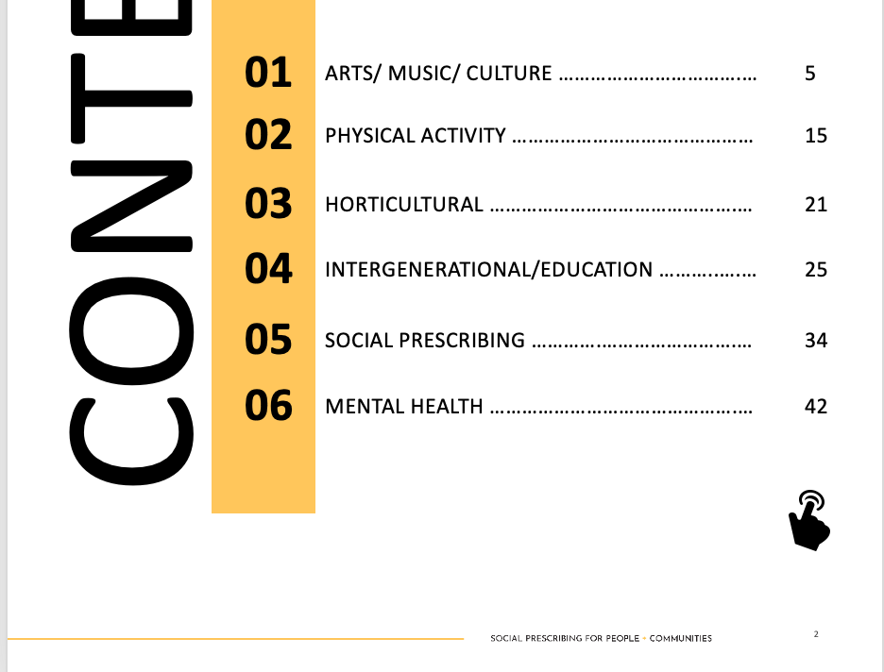


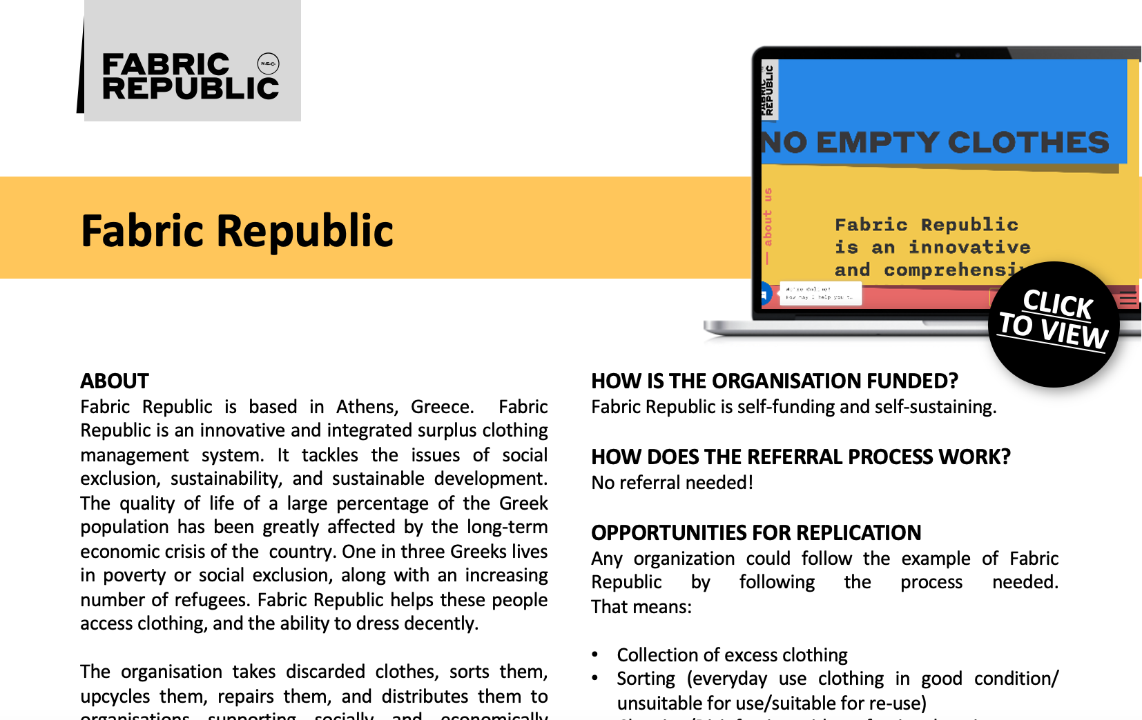

HOW TO
USE THIS
INTERACTIVE GUIDE
Interactive content is identified in this guide by these ICONS
CLICK
TO VIEW
The Activate Compendium is an online interactive guide full of rich media resources (like videos) and additional learning links. This rich media content provides a deeper, self- guided learning opportunity. We invite you to use these links and to explore and engage with the case studies and best practices in more detail.
DEEPER LEARNING - Click to find out more about our case studies
FAST AND EASY NAVIGATION
Jump to a case study section of your choice by
clicking on it in our interactive table of contents.
TOP TIP
To return to the compendium – use the click to go back option in your browser

Slide 5
01
ARTS/ MUSIC/ CULTURE
01
Soyons-Cap
02
Tell me what you are listening to
03
Sing Ireland
04
Culture Vitamins
05
The Melting Pot
06
Fabric Republic
07
Shedia- street newsletter
08
Give Med- medicine donation service
09
Roscommon Reading Group

Slide 6

Soyons-Cap
ABOUT
“Soyons-Cap” is based in France. Specifically, in Région Nouvelle Aquitaine – in three major cities: Bordeaux, Angoulême, Limoges. This organisation works with the unemployed and other socially excluded adults.
These service users are given time and space to develop creatively and personally, in a supportive space. The centre of the programme is a variety of creative workshops. Where service users undertake a variety of creative activities, working with artists.
Service users create personal creative outputs like a ‘love dictionary’ and resumés. The classes and workshops help the service users improve their employability, as they learn skills as varied as hairdressing and dancing. They also gain self-confidence and the ability to work with others, and feel connected.
SUPPORTING SOCIAL INCLUSION
AND CONNECTION
This project supports social inclusion and connectivity because it has brought people who are usually socially excluded out of their homes. The participants said they enjoyed coming to the workshops, discovering and appreciating the practices and the artists.
This project creates strong social links between individuals, and particularly between marginalised people and the artistic world.
SUPPORTING HEALTH, WELLBEING & NUTRITION
Users of this service found their wellbeing improved with their new social connections, their creative achievements, and even just having a reason to get out of the house. The work team encouraged people to take better care of their mental health, and gave them more hope in their ability to build a new future.
SUPPORTINGADULT LEARNING
The project offers training to enable people to access new capabilities. Learning new things in adulthood gives them the keys to self-confidence. It allows people to know their own abilities, and build on them.
The workshops in this programme taught people practices including hairdressing, dancing, graphic design, and writing.
HOW IS THE ORGANISATION FUNDED?
Funding comes through a number of bodies including the French Red Cross, local government, DRAC, and Pole Culture and Sante.
OPPORTUNITIES FOR REPLICATION
This project can be replicated anywhere there are both socially excluded adults, and creative artists to work with them.
MYTHS & FALSE BELIEFS
“The end of the project is the end of the experimentation”
It’s false. This is just the beginning for the participants! All the inputs of this training will mature with time.
Participants will be able to use their creativity and confidence for years to come.
UNLOCKING CREATIVE POTENTIAL IN UNEMPLOYED AND SOCIALLY EXCLUDED ADULTS

Slide 7

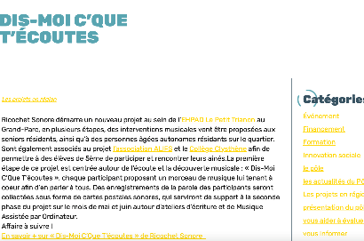
Tell me what you are listening to
CLICK
TO VIEW
ABOUT
“Dis moi c’que t’écoutes” or, in English: “tell me what you are listening to” is based in the southwest of France. It is a project which links older people living in nursing homes with teenagers, to create interviews and podcast projects. Both the older adults and the teenagers were able to learn new skills and express themselves creatively, all while benefitting from the intercultural knowledge exchange of working together.
For more information go to https://culture-sante-aquitaine.com/dis-moi-cque-tecoutes/
http://www.ricochetsonore.fr/actus/365/dis-moi-cque-tecoutes-ehpad-le-petit-trianon
SUPPORTING SOCIAL INCLUSION
AND CONNECTION
This project creates intergenerational connections between teenagers and older adults.
SUPPORTING HEALTH, WELLBEING & NUTRITION
For many older people, it is a challenge to feel active and useful to society. This project and its intergenerational exchanges allows older adults to feel useful and stay active, which is proven to be good for their wellbeing.
SUPPORTING ADULT LEARNING
This project supports adult learning because people were educated on the radio equipment : micro, headphones, machines.
HOW IS THE ORGANISATION FUNDED?
Through the Association du Lien Interculturel Familial et Social
HOW DOES THE REFERRAL PROCESS WORK?
No referral needed! This project is a partnership between individuals, facilitated by schools and nursing homes.
OPPORTUNITIES FOR REPLICATION
This project was repeated several times with the same cultural partner. It could easily be replicated in any place there is the opportunity for collaboration between a school, a nursing home, and a facility with recording equipment.
A RADIO PROJECT CREATING CONNECTIONS BETWEEN
TEENAGERS AND OLDER ADULTS

Slide 8

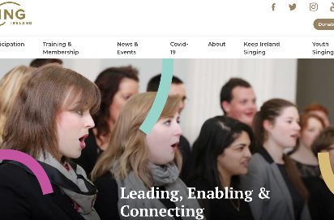
Sing Ireland
CLICK
TO VIEW
ABOUT
Sing Ireland is based in Ireland.
It was established in 1980 to promote and develop choral singing in Ireland. Leading, Enabling and Connecting Communities of Singers in Ireland. Sing Ireland develops and supports all forms of group singing in Ireland. It does this by providing quality experiences through activities led by Sing Ireland and by supporting the work of our members and the wider choral sector.
For more information go to
https://www.singireland.ie/
SUPPORTING SOCIAL INCLUSION
AND CONNECTION
Sing Ireland connects, enables and leads communities of singers in Ireland with a mission to positively enhance people's lives through singing. Each member has the chance to make connections and friends in their singing group.
SUPPORTING ADULT LEARNING
Members could learn through their Sing Ireland group. For instance, they might learn to read music
HOW IS THE ORGANISATION FUNDED?
Sing Ireland has a number of different funders and partners including The Arts Council, University of Limerick, The Department of Culture, Heritage and the Gaeltacht etc.
Individuals and groups also pay to become members.
HOW DOES THE REFERRAL PROCESS WORK?
Individuals can contact Sing Ireland directly to find a group near them.
OPPORTUNITIES FOR REPLICATION
Sing Ireland is like a one stop shop for choirs and singing groups so with some research this could be done in other countries.
MYTHS & FALSE BELIEFS
Myth 1
‘I can’t read music, so I can’t join.’ Not all of the groups or choirs require their members to be able to read music. Some learn by ear.
Myth 2
‘I don’t have enough money to buy sheet music, so I can’t join.’ Many maintain a music library, comprised of all past repertoire. Often members will be asked to contribute a fee towards the running of the group and the purchase of vocal scores.
Myth 3
‘I don’t know what type of voice I have, so I can’t join a choir’. That’s no problem the choir director will get you to sing the scales to determine what kind of voice you have.
Myth 4
‘I’m too old to join’ Sing Ireland and Creative Aging International, supported by Creative Ireland, are developing Ageing Voices to offer tools and networks which encourage singing for health and well-being amongst adults, whether they live in the community or in care.

Slide 9
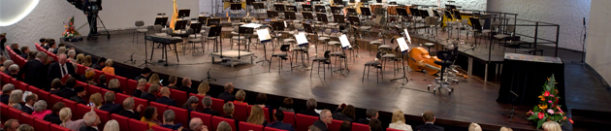
Culture Vitamins
ABOUT
“Kulturvitaminer” or culture vitamins is based in Aalborg, Denmark. The Culture vitamins programmme was aimed at adults who are off work due to mild to moderate depression, anxiety or stress-related issues. The project prescribes a variety of activities including choir singing, guided reading, introduction to the city archives, listing to music, visiting an art museum and a theatre, and a nature hikes. These arts and cultural activities are prescribed at an average of 2-h sessions 2.5 times a week.
For more information go to https://www.aalborg.dk/sundhed-og-sygdom/stress-angst-og-depression/stress-angst-og-depression-kulturvitaminer and
https://www.weforum.org/agenda/2019/08/mental-health-depression-denmark-kulturvitaminer/
SUPPORTING SOCIAL INCLUSION
AND CONNECTION
At the heart of the programme is an ethos of community and belonging. Allowing participants to reconnect or experience first what their local area has to offer and immerse themselves in something meaningful and exciting. With the aim of relieving stress, boosting confidence and promoting new connections. Mikael Odder Nielsen, the Aalborg course leader, explains: “We wanted to see if we could make people’s mental health better, reduce social isolation, and help them get back into the labour market via culture.” A mix of different activities aims to accomplish that goal.
SUPPORTING ADULT LEARNING
Each activity in ‘Culture Vitamins’ offered a new experience of learning which would help relieve some of the problems these adults faced in terms of their mental health. The entire project focused on learning, trying and experience something new as an adult. A professional vocal teacher facilitates participants’ choir singing. The participants are given guided tours in the city archives, and an introduction to genealogical research.
In the theatre, actors and acting coaches train participants in body language to prepare them for job interviews. Moreover, they visit the local art museum and take part in creative workshops — proven to increase resilience.
SUPPORTING HEALTH, WELLBEING & NUTRITION
Anita Jensen, a postdoctoral researcher at Aalborg University, evaluated the successful results of Kulturvitaminer. Participants felt increased self-esteem and motivation, more joy, improved social skills and relationships, and a better sense of their needs and self-care. They not only felt better mentally, but also physically — reporting less fatigue, more energy, and the ability to relax.
SUPPORTING GETTING ACTIVE TO KEEP WELL
As research has shown the positive effect of nature on mental health, Kulturvitaminer also offers guided nature walks which directly encourages people to get outside and be active. “These are also valuable in terms of seeing how slowly things grow, in contrast to our busy modern lives,” states Nielsen (Aalborg course leader).
HOW IS THE ORGANISATION FUNDED?
The Danish Government provided funding for four pilot AoP projects with a 3-year duration starting in 2016. ‘Culture Vitamins’ is one of these projects. The Health and Cultural Department developed the project and it is delivered and coordinated by the Center for Mental Health, which is run by the Aalborg local authority.
HOW DOES THE REFERRAL PROCESS WORK?
Adults were referred to the project by the local job centre. Participants were informed about the study by the project coordinator and recruited prior to the first meeting, at which they received further information
and were introduced to the researcher.
OPPORTUNITIES FOR REPLICATION
The culture vitamins programme could be quite easily replicated in a place that has extensive cultural activities/experience on offer such as libraries, theatres, scenic public spaces in nature. It would require the commitment of course leaders each week and collaboration with these cultural originations.

Slide 10
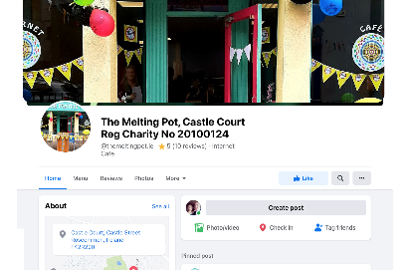
The Melting Pot
CLICK
TO VIEW
ABOUT
The Melting Pot is based in Roscommon, Ireland. It’s a non-profit making organisation. It consists of an Internet Café, Dinner4U meal delivery service, Clothing & Bric-a-brac Charity Shop. It is a space for people to connect with others in the community, and host groups such as a knitting group, a reading group and a music for mental health group. Some describe it as a ‘youth club for adults’. The Melting Pot believes in Social inclusion offering volunteering and work experience.
For more information go to
https://www.facebook.com/themeltingpot.ie
SUPPORTING SOCIAL INCLUSION
AND CONNECTION
The Melting Pot is a great place to meet and connect with people in the community. It is a socially inclusive community space.
SUPPORTING HEALTH, WELLBEING & NUTRITION
The Melting Pot offers a meal service, supporting the health and wellbeing in the county of Roscommon by providing nutritious meals.
SUPPORTING ADULT LEARNING
The Melting Pot supports adult learning by providing volunteer experiences and spaces for group meet ups where people can learn from each another.
HOW IS THE ORGANISATION FUNDED?
It’s a not for profit social enterprise.
HOW DOES THE REFERRAL PROCESS WORK?
The Social Prescribing Co-ordinator introduces the individual to the Melting Pot.
OPPORTUNITIES FOR REPLICATION
Set up a social enterprise to provide a community space and services, providing volunteer experience that people can be socially prescribed to.
MYTHS & FALSE BELIEFS
Myth 1
“I won’t be welcome at the Melting Pot.” This is false. The Melting Pot is socially inclusive.
Myth 2
“The Melting Pot is only for people with mental health issues”. This is false. The Melting Pot is for great all people regardless of mental health diagnoses.
A SPACE FOR PEOPLE TO CONNECT WITH OTHERS IN THE COMMUNITY. “A YOUTH CLUB FOR ADULTS”

Slide 11

Fabric Republic
CLICK
TO VIEW
ABOUT
Fabric Republic is based in Athens, Greece. Fabric Republic is an innovative and integrated surplus clothing management system. It tackles the issues of social exclusion, sustainability, and sustainable development. The quality of life of a large percentage of the Greek population has been greatly affected by the long-term economic crisis of the country. One in three Greeks lives in poverty or social exclusion, along with an increasing number of refugees. Fabric Republic helps these people access clothing, and the ability to dress decently.
The organisation takes discarded clothes, sorts them, upcycles them, repairs them, and distributes them to organisations supporting socially and economically disadvantaged people.
This organization is run by volunteers who deal with the whole process related to the clothes, and the organization employs people who live in a boarding house for people with mental illnesses. These people are given the opportunity to have a daily job, thus having a routine and a regular income while preparing for life after boarding homes.
For more information go to http://www.fabricrepublic.gr/en/
SUPPORTING SOCIAL INCLUSION
AND CONNECTION
Our volunteers, our participants with mental illness, and our professional experts all work together, learning from each other and building connections together.
SUPPORTING ADULT LEARNING
Volunteers and people suffering from mental illness work together and learn new things about the upcycle and repair of clothes. They work side by side with professionals in this field who help them constantly learning new things.
HOW IS THE ORGANISATION FUNDED?
Fabric Republic is self-funding and self-sustaining.
HOW DOES THE REFERRAL PROCESS WORK?
No referral needed!
OPPORTUNITIES FOR REPLICATION
Any organization could follow the example of Fabric Republic by following the process needed.
That means:
Collection of excess clothing
Sorting (everyday use clothing in good condition/ unsuitable for use/suitable for re-use)
Cleaning/Disinfection with professional equipment
Classification (Adult/Women/Children/Infants–S/M/L/XL–Winter/Summer etc.).
Packaging/Storage
Distribution to solidarity organizations with privately owned vehicles
Sending what is unsuitable for use to recycling companies
Reuse (design and production of upcycled creations)
Communication – Dissemination of results
TACKLING SUSTAINABILITY, SOCIAL EXCLUSION, AND POVERTY

Slide 12


Shedia- street newsletter
CLICK
TO VIEW
ABOUT
Shedia is based in Athens, Greece. Shedia is the only Greek street magazine and member of the International Network of Street Papers (INSP), which lists 122 street magazines in 41 countries, with 14,000 homeless, unemployed sellers and 6,000,000 international readers.
Shedia, as with all street magazines in the world, is not sold in the usual press outlets, such as kiosks, but only on city streets by accredited sellers.
The sellers come from socially vulnerable groups: the homeless, the unemployed and generally people who are proven to live below the poverty line.
For more information, go to https://www.shedia.gr/about-us/
SUPPORTING SOCIAL INCLUSION
AND CONNECTION
Shedia gives a special opportunity for homeless people to secure a minimum, decent income, which helps homeless people break free from the vicious circle of social isolation and exclusion. In selling their magazines, these people interact with many more people every day.
SUPPORTING HEALTH, WELLBEING & NUTRITION
Of the € 4.00, which is the selling price of the magazine, € 2.50 goes directly to the seller. This extra income helps homeless people to buy nutritional food and take care of their wellbeing and health needs.
SUPPORTING ADULT LEARNING
Shedia magazine is helping adult, homeless people to get their lives back, by providing them a job and an opportunity to learn skills such as personal finance and sales techniques.
HOW IS THE ORGANISATION FUNDED?
This initiative is funded by Diogenis NGO. It is also part self-funding, as the cost of the magazine covers the cost of printing, organisation, and taxes.
HOW DOES THE REFERRAL PROCESS WORK?
No referral needed!
OPPORTUNITIES FOR REPLICATION
Street magazines provide similar opportunities for homeless populations across the world, and the system has been successful for many decades. The homeless people can choose the topics to be presented in the magazine. Volunteer and support organisations help the magazine to be printed, and homeless people distribute on the streets, just like the Shedia magazine.
MYTHS & FALSE BELIEFS
Myth: giving homeless people money doesn’t really help.
Truth: a steady, stable income allows homeless people to plan for the future and gradually break the cycles of isolation, exclusion, and poverty.
BREAKING THE CYCLE OF EXCLUSION AND POVERTY BY HELPING HOMELESS PEOPLE SECURE A DECENT, STABLE INCOME.

Slide 13


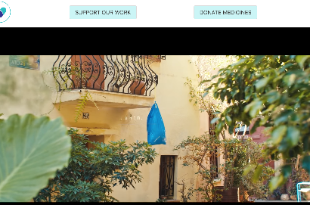
GIVMED - medicine donation service
CLICK
TO VIEW
ABOUT
GIVMED is based in Athens, Greece. GIVMED is a non-profit organization aiming at facilitating access to medicines for all. People can easily and quickly donate the medicines they no longer need to social pharmacies, nursing homes and other public benefit entities. These medicines are provided to people who need them but cannot access them otherwise – groups like the poor, the elderly, refugees and others with limited or no access to medicines.
For more information go to https://givmed.org/en/
SUPPORTING ADULT LEARNING
The objective of the project is the information about the right to health, the improvement of medicine literacy and the compliance with treatment.
GIVMED’s part as the implementing body is the project’s administration and carrying out of informational and empowerment methods. The part of the Institute of Social and Preventive Medicine, as a partner, involves developing the informational and educational material and participating at the healthcare professionals training.
SUPPORTING HEALTH, WELLBEING & NUTRITION
This project helps vulnerable people access essential medication, and therefore greatly improves their health.
The objective of the project is to empower socially vulnerable groups on the following bases:
Informing them of their rights regarding healthcare.
Providing education in terms of handling medicines and medication compliance.
Facilitating their access to the medicines they need through a specific application for smartphones.
HOW DOES THE REFERRAL PROCESS WORK?
The program MEDforNGOs, is exclusively directed to charitable bodies. Through the homonymous specific MEDforNGOs software which has been developed by GIVMED, the public benefit purpose entities may register their medication needs and their medicine surplus that they wish to donate.
Consequently, the information is automatically spread to all the charitable bodies of our network and GIVMED coordinates the whole donation process.
OPPORTUNITIES FOR REPLICATION
Organizations could work with pharmacies and hospitals to know their drug needs. Places will be created where the medicines will be collected and according to the needs that will exist, they will be shared accordingly.
FACILITATING ACCESS TO MEDICINE FOR ALL

Slide 14

Roscommon Reading Group
ABOUT
Roscommon Reading Group is based in Ireland. A group for people who like to read about history, true crime and other genres. Book are read at home and talked about in a group setting.
SUPPORTING SOCIAL INCLUSION AND CONNECTION
It brings people with the same reading interests together to socialise and connect.
SUPPORTING HEALTH, WELLBEING & NUTRITION
Reading and talking about books we are passionate about is a good way to get a sense of wellbeing.
SUPPORTING ADULT LEARNING
Many things can be learned by reading a book and by discussing the books with like-minded people.
HOW IS THE ORGANISATION FUNDED?
This group is not funded.
HOW DOES THE REFERRAL PROCESS WORK?
The social prescribing link worker introduces individuals with the same reading interests into the group.
OPPORTUNITIES FOR REPLICATION
The social prescribing link worker started this group by connecting two people with similar reading interests.
MYTHS & FALSE BELIEFS
Myth 1
‘I’m too old.’ There is no age limit on reading.
Myth 2
“I can’t read well” or “I have impaired vision.” You can still participate if audio books are an option for you.
MANY THINGS CAN BE LEARNED BY READING A BOOK AND BY DISCUSSING IT WITH LIKE-MINDED PEOPLE.

Slide 15
02
PHYSICAL ACTIVITY
10
Ros Sports Partnership
11
Spiral Walks
12
Parkrun
13
Open Water Winter Swimming
14
Laughter Yoga Ireland

Slide 16

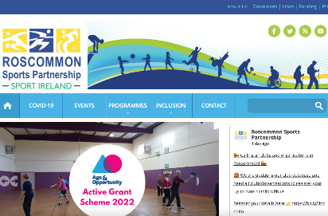
Ros Sports Partnership
CLICK
TO VIEW
ABOUT
Roscommon Sports Partnership was one of the first established Sports Partnerships when it opened in 2002. There are 29 Local Sports Partnerships in Ireland, as part of a national structure to co-ordinate and promote the development of sport and physical activity at a local level. These LSPs undertake a wide range of actions with the aim of increasing sport and physical activity participation levels in their local communities.
For more information go to:
https://www.rosactive.org/
SUPPORTING SOCIAL INCLUSION AND CONNECTION
Joining a sports team, cycling or walking group supports people in making friends, connecting with people and socialising. It supports social inclusion by targeting groups of people that experience social exclusion.
SUPPORTING HEALTH, WELLBEING & NUTRITION
Roscommon Sports partnership supports health and wellbeing by connecting people to local sports clubs and activities.
SUPPORTING GETTING ACTIVE TO KEEP WELL
Roscommon Sports partnership supports getting active by connecting people with groups that do sports and physical activities in the local area.
SUPPORTING ADULT LEARNING
Roscommon Sports Partnerships can support adult learning by exposing adults to sports or activities that they may not have tried before.
HOW IS THE ORGANISATION FUNDED?
The organisation is government funded by
Sport Ireland.
HOW DOES THE REFERRAL PROCESS WORK?
The Social Prescribing Co-ordinator links individuals with suitable local sports activities via Roscommon Sports partnership.
OPPORTUNITIES FOR REPLICATION
Sports Partnerships in Ireland are part of a national network funded by central government. Sports Partnerships could be started on a smaller scale, for example having one in a particular town. It could also be replicated on a cheaper/ more impersonal scale by providing a place for all local sports information to be easily accessed by those in the community (e.g. digital notice board).
MYTHS & FALSE BELIEFS
Myth 1
“I have a disability so I can’t get involved.”
The Sports Partnership welcomes you regardless of ability and offers some activities specifically for people with disabilities.
Myth 2
“I won’t be welcome because I’m from a disadvantaged background.” We welcome people who have been disadvantaged.
GETTING ACTIVE, MAKING FRIENDS, AND CONNECTING WITH PEOPLE

Slide 17
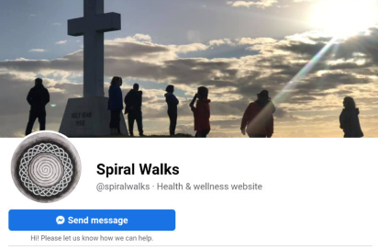
Spiral Walks
CLICK
TO VIEW
ABOUT
Spiral Walks is based in Ireland. It is a walking group for adults. The group meets on an ad-hoc basis. Walks take place as and when volunteers are available to organise and attend them. It is one of many examples of walking groups run by volunteers in Ireland.
They promote connection of body to earth and connection to other likeminded women and men. Freedom and space to feel inspired and love.
For more information go to:
https://www.facebook.com/spiralwalks/
SUPPORTING SOCIAL INCLUSION
AND CONNECTION
People connect with others and make friends in a social situation.
SUPPORTING HEALTH, WELLBEING & NUTRITION
This example supports health and wellbeing with physical activity and social interaction in a natural setting.
SUPPORTING GETTING ACTIVE TO KEEP WELL
Walking is an excellent way for most people to be physically active.
HOW IS THE ORGANISATION FUNDED?
The organisation is not funded. Walks take place as and when volunteers are available to organise and attend them.
HOW DOES THE REFERRAL PROCESS WORK?
The Social Prescribing Coordinator makes the referral and sometimes accompanies the individual to the walks until they feel confident enough to go alone.
OPPORTUNITIES FOR REPLICATION
Walking groups can be easily formed by putting announcements on social media or advertising locally.
MYTHS & FALSE BELIEFS
‘You have to be a hiker with a good level of fitness.’
This is false for this group. It could be true for other walking groups so be sure to check!
A SPACE TO FEEL CONNECTED TO YOUR BODY, TO THE EARTH, AND TO LIKEMINDED PEOPLE.

Slide 18

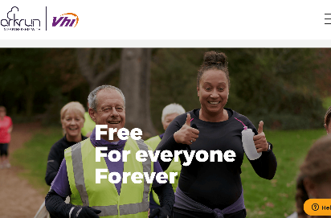
Parkrun
CLICK
TO VIEW
ABOUT
Parkrun is based in Ireland and 22 other countries around the world. For this case study we are focusing on Ireland. Parkrun Ireland is a weekly timed 5k run or walk. It takes place in 98 locations in Ireland and the hope is that there will be a parkrun in every community in Ireland that would like one.
For more information go to:
https://www.parkrun.ie/
SUPPORTING SOCIAL INCLUSION
AND CONNECTION
The Parkrun community is friendly and welcoming, they celebrate milestones, and they often have refreshments after some runs. The Sligo Parkrun is also host to the Sligo Sanctuary Runners, these are people who live in direct provision and the local community of
supporters.
SUPPORTING GETTING ACTIVE TO KEEP WELL
Parkrun encourages participants to get out and active. Many of them try to beat their personal best record.
HOW IS THE ORGANISATION FUNDED?
Parkrun is free for participants and is sponsored by VHI, Healthy Ireland, and the HSE.
HOW DOES THE REFERRAL PROCESS WORK?
No referral is needed. People can sign up online and register for a barcode that is used to time their run or walk.
OPPORTUNITIES FOR REPLICATION
Parkrun is replicated in 23 countries around the world, and they are always looking for more people to join. There is a page on the website for people to register to find out more information if they want to start a Parkrun in their community.
https://www.parkrun.com/about/start-your-own-event/
MYTHS & FALSE BELIEFS
Myth 1
I’m not fit enough to join Parkrun’
Anyone can join and go at their own pace.
Myth 2
‘I don’t have a computer to register, so I can’t join.’
Anyone can register you to take part.
Myth 3
‘Children can’t take part.’ Children over the age of 4 are encouraged to join in. Runners can also push a child in a buggy.
Myth 4
‘I’m away on holiday, so I’ll miss the parkrun in my area’.
Members can join in any parkrun in any location

Slide 19
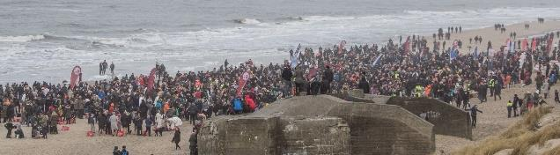
Open Water Winter Swimming
ABOUT
Radet for Starre Badesikkerhed is an organisation for winter swimming based in Denmark, in the North Jutland Region. Many Scandinavians swear by winter swimming, saying that it serves as a mood booster during the long, dark winters. In the north of Denmark, winter swimming is seen as healthy for the body, good for the mind- and it fosters a strong community of enthusiasts. It is said to improve people’s wellbeing and attitude towards long dark winters. It is perfect for anyone suffering seasonal depression, which is common in Nordic countries.
This social prescribing example is perfect for adults of any age, although you must be able to swim or at least float. There are some 90 official winter swimming clubs across Denmark with more than 20,000 registered members.
For more information go to https://www.visitdenmark.com/denmark/things-do/winter/winter-swimming
https://www.badesikkerhed.dk/en/adults/winter-bathing/ https://www.bbc.com/worklife/article/20200228-the-danish-trick-to-shock-your-body-into-happiness
SUPPORTING SOCIAL INCLUSION
AND CONNECTION
These winter swimming clubs are highly social! They promote a culture of community and team spirit as people brave the cold winter water together.
SUPPORTING GETTING ACTIVE TO KEEP WELL
“When you throw yourself into the cold water and then into a boiling sauna, it gives you energy and an enormous endorphin kick.” says Møller, avid winter water swimmer. Swimming is a great activity to keep people fit and healthy. While winter swimming means you will typically spend less time in the water because of the severely cold conditions, the benefits are still fantastic. It allows swimmers to raise and lower their heart rate and become fitter upon each swim.
HOW IS THE ORGANISATION FUNDED?
It is free! Bathing beaches are open to public access. Some clubs may charge a membership fee for the benefits they provide. Some hotels/Spas provide saunas and hot tubs along with winter water dips will likely charge a usage fee.
HOW DOES THE REFERRAL PROCESS WORK?
There is no referral process! People can either sign up to one of the 93 clubs and enjoy the membership this offers; this is a great way to get to socialize with others and is recommended for those new to winter swimming activity. However, people can also just turn up at any official bathing beach in their municipality.
Radet for Starre Badesikkerhed recommend the following:
All healthy persons are allowed to winter bathe
People with heart conditions or high blood pressure should have the approval from their doctor before winter bathing
Do not winter bathe if you have a cold, fever or otherwise feel uncomfortable
No bathing under the influence of alcohol, medicine or drugs.
OPPORTUNITIES FOR REPLICATION
Winter swimming is easily replicable all over the world where there are public beaches, loughs, lakes and so forth. It can be set up by individuals and would be a matter of spreading the word through social media, local community’s or clubs to let people know the benefits of winter swimming. It is certainly growing in popularity across Ireland and UK. When starting a new club, Radet for Starre Badesikkerhed recommend the following:
A safety risk assessment of the beach should be carried out.
There should be signage with safety information.
The beaches use should have achieved a blue flag
There should be a lifeguard inspection and rescue equipment.
The beaches should be provided with beach identification numbers.
Someone should be able to alert emergency services if needed.

Slide 20


Laughter Yoga Ireland
CLICK
TO VIEW
ABOUT
Laughter Yoga is based in Ireland. Laughter Yoga is a combination of yogic deep breathing and childlike playfulness. Laughter Yoga Ireland was founded by Mary Ananda Shakti in 2002 after training in Munich with the founder Cardiologist Dr Madan Kataria. Laughter Yoga Ireland hosts workshops in Laughter Yoga. They also train others to become Laughter Yoga facilitators.
For more information go to
https://laughteryogaireland.org/
SUPPORTING SOCIAL INCLUSION
AND CONNECTION
Laughter Yoga can be enjoyed by all ages. The workshops are mainly aimed at adults and for those who can’t physically attended, there are also workshops held on zoom. Nothing breaks the ice more than a room of people laughing. Laughter is a positive energy which helps people to connect with other people quickly and improves relationships. Laughter Yoga can also improve self-confidence.
SUPPORTING GETTING ACTIVE TO KEEP WELL
Laughter Yoga is like an aerobic exercise (cardio workout) which brings more oxygen to the body and brain thereby making one feel more energetic and relaxed.
SUPPORTING ADULT LEARNING
Laughter Yoga can support adult learning by training people to become laughter yoga facilitators
HOW IS THE ORGANISATION FUNDED?
Individuals and community groups, workplaces etc. pay to take workshops.
HOW DOES THE REFERRAL PROCESS WORK?
There’s no referral process as such. People who are interested in finding out more can make contact through the website.
OPPORTUNITIES FOR REPLICATION
Laughter Yoga is available in a number of countries already and can easily be replicated if interested individuals took a training course to facilitate groups in laughter yoga workshops and clubs.
MYTHS & FALSE BELIEFS
‘I don’t like yoga so I can’t do this’.
Laughter Yoga is very different to conventional yoga, you don’t have to lie on the floor and do stretches, it’s all about laughing.
LAUGHTER IS A POSITIVE ENERGY WHICH HELPS PEOPLE TO CONNECT.
NO BETTER ICE BREAKER THAN A ROOM OF PEOPLE LAUGHING.

Slide 21
03
HORTICULTURAL
15
Tidy Towns
16
GROW
17
Social Vegetable Garden for oncology patients

Slide 22

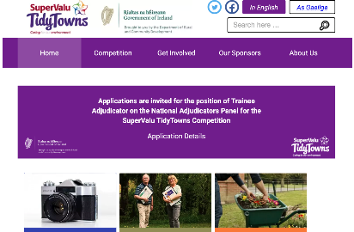
Tidy Towns
CLICK
TO VIEW
ABOUT
Tidy Towns is based in Ireland. It’s an Irish national community initiative and friendly annual competition, first held in 1958. The primary focus of Tidy Towns was to encourage communities to improve their local environment and make their area a better place to live, work and visit. The competition seeks to honour the most attractive and tidiest cities, towns and villages in the Republic of Ireland. Community volunteers work together each year to compete.
For more information go to:
https://www.tidytowns.ie/
SUPPORTING SOCIAL INCLUSION
AND CONNECTION
Tidy Towns is a fantastic way to meet people from the local community, form connections and make new friends. Tidy Towns is socially inclusive and everyone is welcome.
SUPPORTING HEALTH, WELLBEING & NUTRITION
Tidy Towns supports health and wellbeing by creating and maintaining a pleasant environment for everyone in the community.
SUPPORTING GETTING ACTIVE TO KEEP WELL
Many Tidy Towns volunteers engage in physical activity such as gardening, litter control and nature preservation.
SUPPORTING ADULT LEARNING
Volunteers have the opportunity to learn about topics related to Tidy Towns, such as Biodiversity and Community Planning.
HOW IS THE ORGANISATION FUNDED?
The Department of Arts, Heritage, Regional, Rural and Gaeltacht Affairs assumed responsibility for Tidy Towns and now organises the initiative with the support of a national sponsor supermarket SuperValu and a number of other agencies.
HOW DOES THE REFERRAL PROCESS WORK?
The Social Prescribing Coordinator makes the referral and sometimes accompanies the individual to the walks until they feel confident enough to go alone.
OPPORTUNITIES FOR REPLICATION
Tidy Towns could be replicated on a smaller scale, such as within a county. On an even smaller scale, an area of a town could hold a ‘Tidy Streets’ competition.
MYTHS & FALSE BELIEFS
Myth 1
“I need to be physically fit to be involved in Tidy Towns.” This is not true. While some Tidy Towns activities are physical, there are also non-physical activities to get involved in.
Myth 2
“I am not interested in gardening.” That doesn’t matter. There are non-gardening activities available.
Myth 3
“I like gardening but I’m not very good at it.” That doesn’t matter. There are simple gardening activities you can do and you will have opportunities to learn more if you want to.

Slide 23

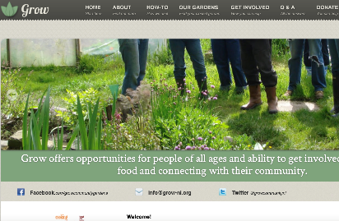
GROW
CLICK
TO VIEW
ABOUT
GROW based in Northern Ireland is a registered charity utilising community gardens and urban green spaces; it promotes and develops organic planting and farming. Research has demonstrated that gardens promote wellbeing, build community cohesion and good mental health. In addition to weekly sessions, there are community events which are open to all, celebrating diversity and social integration, addressing inequalities and supporting the growing and fair distribution of healthy foods. GROW offers opportunities for people of all ages, genders and abilities to get involved in growing food and connecting with their community.
http://www.grow-ni.org
SUPPORTING SOCIAL INCLUSION
AND CONNECTION
Grow supports the development of healthy inclusive communities in Northern Ireland. Bringing together those who may be isolated, suffering with mental or physical health issues, or those who just want to spend a bit more time outdoors, all the while enriching the local area and addressing neighbourhood issues. There are cookery demonstrations using fresh produce and everyone eating together as a communal gathering.
SUPPORTING HEALTH, WELLBEING & NUTRITION
Research has recognized that gardens promote wellbeing, build community cohesion and good mental health. In fact, soil can act as an antidepressant and has therapeutic effects. It helps people to keep connected with living things; helping individuals to be more mindful and present in the moment. Eating freshly grown food has obvious health benefits.
SUPPORTING GETTING ACTIVE TO KEEP WELL
There are other activities besides gardening, including park clean-up, area developments, building, plumbing, carpentry and woodwork, DIY. Most activities are outdoors encouraging embracing nature, as well as making a positive impact on their surrounding environment.
SUPPORTING ADULT LEARNING
Volunteers assist in running and organisational upkeep, liaising with decision-makers, funders, public and media. Developing organic gardening skills and knowledge. Also engaging in the administration and IT, delivering cookery demonstrations and engaging in serving fresh produce. Team work!
HOW IS THE ORGANISATION FUNDED?
Funding grants have been awarded by the National Lottery Community Fund and European Regional Development Fund. Fund-raising is very dynamic with many activities and sponsored events. Facebook, social media and online donations contribute actively, and also funds are raised from schools and colleges programmes.
HOW DOES THE REFERRAL PROCESS WORK?
Application forms are available online
OPPORTUNITIES FOR REPLICATION
These nature schemes have been replicated in many countries and proven invaluable to those who suffer from any form of anxiety, depression, stress or isolation.
MYTHS & FALSE BELIEFS
“I am not very good with plants”
“I have health issues which would make gardening difficult”
Both untrue:
There are other events and occasions as well as the horticulture activities, there are facilities and resources provided for all abilities.

Slide 24


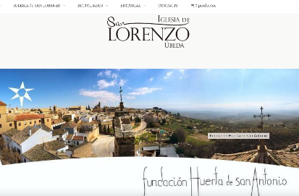
Social Vegetable Garden for oncology patients
CLICK
TO VIEW
ABOUT
Asociacion Española Contra el Cancer (Spanish Association Against Cancer) in Jaen (one of the Provinces of Andalusia) and Fundación Huerta de San Antonio (Saint Anthony's Orchard Foundation) are based in the Ubeda(Jaen ) region. Joint initiative between the Spanish Association Against Cancer (AECC) in the Province of Jaen and the Huerta de San Antonio Foundation (in the city of Ubeda) Defined in the “On the march for health” Program, which aims to promote healthy lifestyle habits in the population, this initiative of healthy vegetable gardens aims to improve the quality of life of people affected by cancer. It is based on a program led by a horticultural therapist, who helps to regain personal autonomy, improve physical, cognitive and emotional functioning, social skills and healthy lifestyle habits, including activities such as mindfulness or healthy eating.
Additionally, the project aims to recover the surroundings of the San Lorenzo neighbourhood, in Ubeda, including its church and the traditional orchards and vegetable gardens that surround this old neighbourhood of the city. The project seeks to assist cancer patients, as well as patients suffering from other diseases limiting their personal autonomy and self-esteem. https://www.iglesiasanlorenzoubeda.com/fundacion-huerta-de-san-antonio/
SUPPORTING SOCIAL INCLUSION
AND CONNECTION
It is recognized that work in social gardens is both an educational and socialising tool. Activities require participant commitment to a collaborative project, alongside other activities which they interact with others with shared interests and culture.
SUPPORTING HEALTH,
WELLBEING & NUTRITION
Project objectives of improving the health and quality of life of the cancer patients. Gardening is key in improving health and well-being. Project also runs workshops to promote healthy eating.
SUPPORTING ADULT LEARNING
The project seeks to replicate centuries old supply of fruit and vegetable gardens which was lost 50 years ago. This project seeks to recover lost horticultural trades. The Huerta de San Antonio Foundation also promotes adult learning (literary gatherings, art exhibitions, concerts, etc.)
HOW IS THE ORGANISATION FUNDED?
The Spanish Association for Cancer and income generated for produce sales
HOW DOES THE REFERRAL PROCESS WORK?
Self referrals through free phone INFOCANCER - 900 100 036 or Local Board of Ubeda of the AECC/ Ubeda Hospital. Psychological assessment of medical, physical and emotional condition of potential participants.
OPPORTUNITIES FOR REPLICATION
Yes, any European country with the necessary ingredients could replicate this project.
MYTHS & FALSE BELIEFS
I will be unable to make the physical effort required
The physical recovery of patients is closely monitored by health professionals
I am ashamed to be identified as a cancer patient.
Being a cancer patient is not a social stigma. The project provides psycho-oncological support
I have no idea how to garden
No experience required, you will be supported to learn

Slide 25
04
INTERGENERATIONAL/EDUCATION
18
Nous Viellions Ensemble- we will grow old together
19
In Good Age
20
Open classrooms for seniors
21
Mens Shed
22
Change of View
23
Connect your city
24
CINTER- Intergenerational Reference Centre
25
Roscommon Women's Network

Slide 26
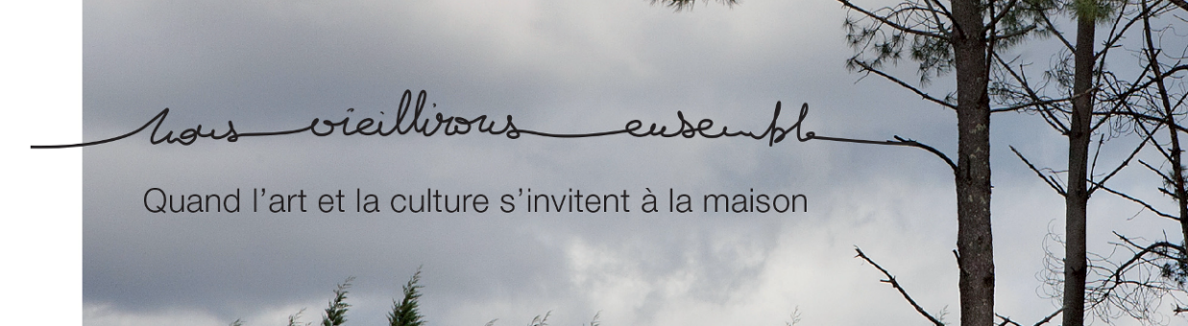
Nous Viellions Ensemble - we will grow old together
ABOUT
“Nous vieillirons ensemble” or in English, “We will grow old together” is based in France.
This project exists for older people who still live at home. It also benefits care professionals and artists. The aim of the project is to reduce the isolation of older people by connecting them with artists and care professionals.
Older people living alone are taught digital skills they need to find activities happening locally, and artists lead both the older people and the care professionals in artistic activities to improve their own artistic skills. Artists visit the homes of older people alongside care professionals. This builds more positive associations between care staff and adults who need care, and gives the care staff and the older adults a joint activity to do. This strengthens the relationship.
For more information go to
https://culture-sante-aquitaine.com/le-laboratoire/nos-projets/nous-vieillirons-ensemble/
https://culture-sante-aquitaine.com/wp-content/uploads/ColloqueArtSante-Programme.pdf
SUPPORTING SOCIAL INCLUSION
AND CONNECTION
This project supports social inclusion because it brings the creative world into people’s homes. This project allows relationships between older people and professionals in care. This project helps older people and the people who work with them to connect over common creative interests. This provides new human moments between older adults and health professionals.
It helps older adults learn how to access activities outside their homes too.
SUPPORTING ADULT LEARNING
This project helped older adults gain digital skills. Through an app, people were able to to discover what was going on in the city around them.
SUPPORTING GETTING ACTIVE TO KEEP WELL
People were able to discover artistic activities to enjoy, which encourages them to become active in the world outside of their homes. They can build social links through the workshops.
HOW IS THE ORGANISATION FUNDED?
Funding comes from a variety of sources, including Départment des Landes, Région Nouvelle-Aquitaine, AGR2R La Mondiale, Agence Régionale de Santé, and DRAC.
OPPORTUNITIES FOR REPLICATION
The project can be reproduced in other countries if there are public policies which connect culture and well-being. Local authorities can obtain financial aid and support from these policies to act together. If the same French system exists in other countries for the elderly, this project could be useful for them!

Slide 27

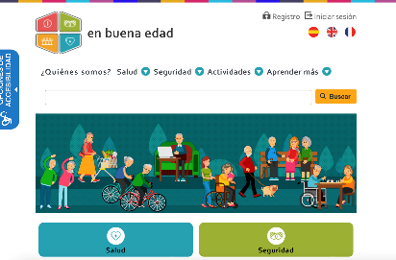
In Good Age
CLICK
TO VIEW
ABOUT
In Good Age is based in Andalusia, Spain. It is part of the Project "Promotion of active aging through digital solutions" Led by the Andalusian Regional Government's Health and Family Department. They provide social prescribing support to encourage active and healthy aging. They work both directly with older adults and with organisations supporting older adults.
From January 1st to December 31st, 2020, the platform www.enbuenaedad.es has received 133,786 visits from 45,007 unique users.
There is information on how to explore the web platform here: https://www.youtube.com/watch?v=cabSlu4UB_g
SUPPORTING SOCIAL INCLUSION
AND CONNECTION
Firstly, it encourages older adults' learning in the use of digital tools, which allows them to access a new dimension in which they can communicate with other people. Secondly, it disseminates and promotes joint activities, both face-to-face and online, which allows establishing and strengthening links among different people and groups.
SUPPORTING HEALTH, WELLBEING & NUTRITION
The promotion of health and well-being is carried out through different means in the various sections of the platform. The platform shares evidence based resources on physical activity, emotional well-being or health care. Nutrition is widely treated on the platform through videos, tutorials and traditional recipes of the Mediterranean diet.
SUPPORTING GETTING ACTIVE TO KEEP WELL
In Good Age provides apps that help you stay in shape, to a wide catalogue of hiking routes and the possibility of organizing groups of people to traverse them. It also provides information on in-person activities that promote physical exercise and the holding of various types of workshops throughout Andalusia.
HOW IS THE ORGANISATION FUNDED?
The project is funded by the Andalusian Government and the European Regional Development Fund (Operational Program 2014 - 2020).
HOW DOES THE REFERRAL PROCESS WORK?
People who wish can freely access the platform. For activities like taking online courses available on it, only a simple registration process is required. In the case of activities of any kind organized by other entities, the contact is provided on the platform, but the management of requests corresponds, in these cases, to those other entities.
OPPORTUNITIES FOR REPLICATION
Other regions can replicate this project by creating a platform with information on healthy aging and the programmes available for it in the area.
MYTHS & FALSE BELIEFS
MYTH People who retire have already done enough in life. Taking care of their grandchildren and strolling is enough.
TRUTH The improvement of our health systems and living conditions has increased life expectancy to levels unimaginable 50 years ago. Retirees can carry out a multitude of activities and maintain an intense social life.
MYTH It’s embarrassing to participate in activities for retired people.
TRUTH Many of these activities are by no means exclusive for retirees, not even for those over 55. Most of them allow to share spaces and

Slide 28

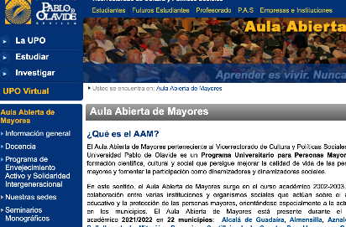
Open classrooms for seniors
CLICK
TO VIEW
ABOUT
Open Classroom for Seniors is based in Pablo de Olavide University – Seville. It is a university program for older adults, with scientific, cultural and social training that seeks to improve the quality of life of those people and promote their participation as social promoters. More than 10,000 people have passed through its classrooms since 2003. 22 Municipalities of the Province of Seville participate in the training program. The training program combines academic sessions in each participating municipality, academic sessions at the University and socio-cultural activities.
For more information go to
https://www.upo.es/aula-mayores
SUPPORTING SOCIAL INCLUSION
AND CONNECTION
The people who participate in this programme become part of a group of people united by common interests, who work on them together and share their results.
The contents of the training focuses on specific aspects of local municipalities, with the aim that the students become revitalising agents of the rural world.
SUPPORTING ADULT LEARNING
"Learning is living. Never stop learning." This quotation, the Program's slogan, is key to this. Participating in it keeps older adults physically active while the acquisition of knowledge allows their minds to remain agile. In this way, the participants realize that their learning process in life continues, they feel they are fulfilled.
SUPPORTING GETTING
ACTIVE TO KEEP WELL
Attendance to classes and complementary activities keep participants active in body and mind!
HOW IS THE ORGANISATION FUNDED?
Through the Pablo de Olavide University (Seville), with the collaboration of the Diputacion de Sevilla, “La Caixa" Social Work and the Department of Equality, Social Policies and Conciliation of the Government of Andalusia.
HOW DOES THE REFERRAL PROCESS WORK?
Interested people over 50 must pre-register at their Town Hall. Subsequently, the registrations will be formalized online. To help in the process, there are Local Coordinators in the towns that participate in the Program.
OPPORTUNITIES FOR REPLICATION
Any entity dedicated to teaching can launch initiatives of this type, although it is true that it is important to have the support of associations, administrations or, as in the good practice presented, the social work of a banking entity.
MYTHS & FALSE BELIEFS
Myth. 1:
I am too old to go to class. The motto of the Open Classroom for Seniors answers by itself: "Learning is living. Never stop learning." Keep learning will make you set new goals, make you feel fulfilled, useful. It will also affect your physical and mental well-being.
Myth. 2:
I do not have a level of studies to be able to access. For initial access, only a series of basic skills are required, without the need for a prior qualification. As you progress through the Curriculum, you will increase your training and will be able to access more training content.

Slide 29

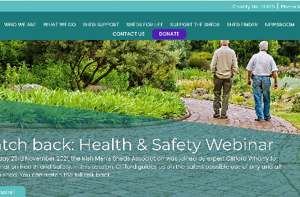
Mens Shed
CLICK
TO VIEW
ABOUT
Men’s Sheds are based in Ireland.
A ‘men’s shed’ is a community based project, where men can come together to learn, share skills and make long-lasting friendships. All sheds are independent and self-autonomous, and the range of activities carried out by sheds differ from the next. Most sheds engage in activities such as woodwork, gardening, carpentry and community work. However, there are more special interests sheds that focus on things like music, fishing and restoration work.
For more information go to:
https://menssheds.ie/
SUPPORTING SOCIAL INCLUSION
AND CONNECTION
Men’s sheds are more than just woodwork or gardening, they are places where men can find meaning and purpose, where a friend is always there. In a men’s shed we always say the greatest tool we have is the kettle, because there’s nothing more powerful than a cup of tea and a chat.
SUPPORTING HEALTH, WELLBEING & NUTRITION
Men’s sheds contribute to positive mental health by providing a welcoming space to make friends and talk, reducing social isolation and loneliness. Over 90% of shedders believe the shed has improved their wellbeing.
SUPPORTING GETTING ACTIVE TO KEEP WELL
There are many different types of activities that go on in men’s sheds, some are more physically demanding than others. Woodwork, carpentry and gardening are a few examples.
SUPPORTING ADULT LEARNING
There are opportunities to learn new skills at men’s sheds. These vary depending on the individual shed.
HOW IS THE ORGANISATION FUNDED?
In Ireland the men’s shed is a registered charity. Some sheds are funded with a yearly subscription model, whilst others get involved in fundraising activities to fund their sheds.
HOW DOES THE REFERRAL PROCESS WORK?
In Ireland, the local Social Prescribing Coordinator makes the introduction. They work with the participant to attend the first meeting or two until the participant is confident enough to go alone.
OPPORTUNITIES FOR REPLICATION
The Irish Men’s Sheds website explains how to start a men’s shed. There is a 5 step process, which can be replicated in other countries. The steps are: - 1. Hold an information meeting 2. Form a working group 3. Find suitable premises 4. Consider insurance 5. Planning and registering. For a more detailed explanation, visit: https://menssheds.ie/setting-up-a-shed/
MYTHS & FALSE BELIEFS
Myth 1
“I’m too old.” or “I’m too young to join a shed.”
The only age requirement is that you must be an adult.
Myth 2
“I have the wrong background to join a shed “ Men’s Sheds are open to all men regardless of background.
Myth 3
“I can’t join a shed because I have a disability” Men’s Sheds are open to all men regardless of ability.

Slide 30

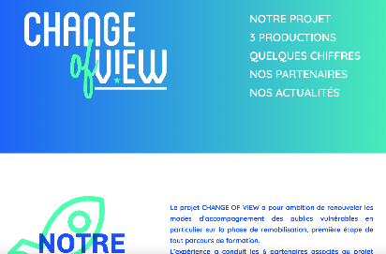
Change of View
CLICK
TO VIEW
ABOUT
“Change of View” is based across Europe. The project is a game board intended to be used by professionals in working supportively and educationally with vulnerable populations. The game challenges vulnerable people’s internalised biases, and negative self-beliefs.
The game was developed by a number of European partners, and anyone can find it on web. Through playing the game, users get more knowledge about their own points of view and the points of view of others. The game is empowering and allows users to direct their own learning process. This social prescribing example was created for the educators and professionals working with vulnerable populations.
For more information go to
https://change-of-view.eu/
https://culture-sante-aquitaine.com/le-laboratoire/nos-projets/change-of-view/
https://www.facebook.com/ChangeOfView.Erasmus/
SUPPORTING SOCIAL INCLUSION
AND CONNECTION
This project allows vulnerable people to play games together online. The game facilitates inclusion because by using this game, vulnerable people gain self-esteem and social skills. Through the game, these people gain the skills and confidence to be more active in society.
SUPPORTING ADULT LEARNING
The game allows vulnerable adults to understand more about their own minds, and their own beliefs. As a digital game, it also helps develop digital skills.
HOW IS THE ORGANISATION FUNDED?
This organization is funded by ERASMUS+ and the French Red-Cross.
HOW DOES THE REFERRAL PROCESS WORK?
The game is available for free online for any professionals to use with vulnerable populations they support.
OPPORTUNITIES FOR REPLICATION
This project was born from a cooperation between several European countries. Together, new tools can be invented!
MYTHS & FALSE BELIEFS
- “This is a social prescription for adults only”
It’s false – the game is appropriate for all ages. Children too, can benefit from improved self esteem.
CREATING SELF CONFIDENCE AND STRENGTHENING SOCIAL SKILLS FOR VULNERABLE YOUTH.

Slide 31


CONNECT YOUR CITY
CLICK
TO VIEW
ABOUT
CONNECT YOUR CITY is based in Athens, Greece. It is the first integrated Youth Centre in the country, providing an open meeting place for young people aged 16 to 30. These people have the opportunity to use their free time creatively, to develop their skills - through educational programs - and finally to have the opportunity to enter the labour market, through of the Job Club. CONNECT YOUR CITY strives to offer the new generation an interactive communication and action platform.
For more information go to http://www.connectathens.gr
SUPPORTING SOCIAL INCLUSION
AND CONNECTION
The aim of CONNECT YOUR CITY is to empower young people, and N.E.E.T.s (Not in Education, Employment, or Training) in general, through sports, arts, trainings, volunteering, entertaining activities and active citizenship motivation. It focuses on connecting young people with potential employers and strengthening their first efforts and steps in the business world, as young entrepreneurs. ​
Wanting to give young people a voice, it set up Local Youth Councils where young people discuss their issues and make policy proposals. ​ CONNECT YOUR CITY is self-operated by young members and volunteers of the organization. This gives a chance for these young people to be meaningfully active in their community.
CONNECT YOUR CITY members developed a volunteering service in order to offer some services that the municipalities cannot manage to provide to the community. These volunteers take actions such as neighborhood and beach cleanings and assisting vulnerable members of the community, such as refugees, elderly people, people with, children with health problems, etc.)
SUPPORTING GETTING
ACTIVE TO KEEP WELL
CONNECT YOUR CITY organizes various sports activities, aiming at spiritual and physical empowerment. It cultivates values such as team spirit, equality, respect and fair play. CONNECT YOUR CITY is active as the volunteering team of the Hellenic Olympic Committee.
SUPPORTING ADULT LEARNING
CONNECT YOUR CITY through the Academy aims to enhance the soft skills of young people by educating them in order to obtain the appropriate training for their smooth integration into working life and the labour market.
HOW IS THE ORGANISATION FUNDED?
Funding is provided by IASIS NGO.
HOW DOES THE REFERRAL PROCESS WORK?
No referral needed! This is a youth led organisation, and any young people who believe in its aims are welcome to join.
OPPORTUNITIES FOR REPLICATION
CONNECT YOUR CITY can be replicated anywhere there is a youth centre willing to work with local communities and other organisations to do volunteering actions.
FOR YOUNG PEOPLE, BY YOUNG PEOPLE, FOR THE GOOD OF THE COMMUNITY.

Slide 32

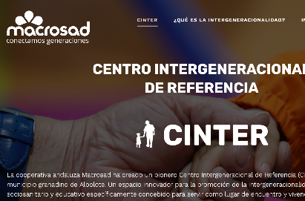
CINTER- Intergenerational Reference Centre
CLICK
TO VIEW
ABOUT
CINTER Intergenerational Reference Centre is based in Albolote (Granada) – Spain. The Centre works to promote intergenerational connections, creating opportunities for children and adults 50+ to work common goals in a mutually beneficial way, where space, time, thought and a culture are shared among different generations. This Chair has created a specific space for intergenerational issues that was unprecedented in Spanish universities. 40 older people are participating in the CINTER.
For more information go to https://www.centrointergeneracionaldereferencia.com/
SUPPORTING SOCIAL INCLUSION
AND CONNECTION
CINTER has been proven to help older people once again feel useful, necessary, a source of knowledge and capable of teaching others. CINTER encourages adults and children in joint activities, sharing not only spaces but also experiences, life lessons, feelings, etc. It has been empirically proven that CINTER increases how involved older adults are in the activities they carry out, and it decreases apathetic or demotivating behaviours.
In addition to the specific and common activities that encourage the learning of older people (games, technology, etc.), older people learn that they can continue to learn from children. It opens their minds like they could not imagine.
SUPPORTING HEALTH, WELLBEING & NUTRITION
CINTER is proven to stabilize older adults’ cognitive level, and increase their happiness and satisfaction, progressively decreasing the need for medication. It also increases their self-esteem, feeling satisfied and fulfilled people, so the improvement of their happiness and quality of life is also worked on.
SUPPORTING GETTING
ACTIVE TO KEEP WELL
There is a whole program of activities of various kinds, both indoors and outdoors, that encourage physical activity.
HOW IS THE ORGANISATION FUNDED?
For older people, 25% of the financing is private (older adults and / or their families) and 75% public (Government of Andalusia). For children, their places are public, but from 0 -3 years old, families must co-finance according to their income.
HOW DOES THE REFERRAL PROCESS WORK?
Older adults are referred by Community Social Services. Participation in the intergenerational program is voluntary.
OPPORTUNITIES FOR REPLICATION
There are residences and day centres for older adults and nursery schools everywhere throughout Europe. The key is that they decide to start up little by little and jointly programs of intergenerational activities.
MYTHS & FALSE BELIEFS
Myth. 1:
Activities are boring and burdensome for older adults.
If the design and scheduling of activities is correct, this is not so. To do this, first of all, the needs and motivations of the elderly and young people or children must be known and determine where intergenerational learning bears the better results.
Myth. 2:
A nursery school is not a place for activities with older adults, nor a residence for children.
The activities are always voluntary and are carried out in prepared and attractive spaces for both adults and children. These are pleasant spaces even for the most reluctant people.

Slide 33

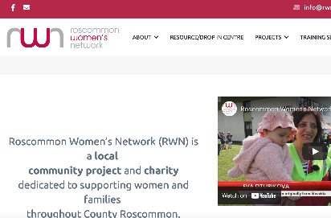
Roscommon Women's Network
CLICK
TO VIEW
ABOUT
Roscommon Women’s Network (RWN) is based in Roscommon, Ireland. They are a local community project and charity dedicated to supporting women and families throughout county Roscommon, especially the most marginalised. They connect and engage with not just women but every member of the community experiencing disadvantage through the Resource centre, Outreach and Predevelopment work. They are part of the National Collective of Community Based Women’s Networks.
For more information go to
https://rwn.ie/
SUPPORTING SOCIAL INCLUSION
AND CONNECTION
The Network is led by the members so they look at what is needed and come up with a plan around those needs. The network run a charity shop, which also tackles loneliness and isolation, providing a space for participation, rehabilitation, learning new skills and progressing into training, education and employment. This gives women the opportunity to connect with others and be part of something worthwhile.
SUPPORTING HEALTH, WELLBEING & NUTRITION
RWN has also been running the very popular ‘A Healthier Greener You’ course in conjunction with GRETB and Roscommon County Council. This course includes cookery, shopping tips, and more. It touches on nutrition.
SUPPORTING ADULT LEARNING
The Roscommon Women’s Network host a number of courses and workshops. The full-time courses include: Healthcare, Computers, Retail and more. Part-time courses include: Digital skills, AgFood, Textile skills.
HOW IS THE ORGANISATION FUNDED?
The Project Co-ordinator and part-time development worker are funded through the National Collective of Community Based Networks (NCCWN). The Network is a registered charity and they also run a charity shop where the proceeds go back into the network. The National Collective of Women’s Networks is funded by the Department of Justice and Equality.
HOW DOES THE REFERRAL PROCESS WORK?
The Roscommon Women’s Network maintain a walk-in, nonreferral drop-in/information centre in the heart of Castlerea.
OPPORTUNITIES FOR REPLICATION
There is a lot of information on the National Collective of Women’s Networks, which would give other countries an insight as to what the organisation is about https://nccwn.org/
MYTHS & FALSE BELIEFS
‘English is not my first language so I can’t join’ The Roscommon Women’s Network celebrates cultural diversity and inclusion. RWN have connected with members of many cultures living in the county including, Romanian, Polish, African, Slovakian, Irish, Portuguese, Lithuanian, people from the UK, Brazil, Irish Travelling Community, Syria, Germany, Pakistan, Russia, Croatia, to name a few.

Slide 34
05
SOCIAL PRESCRIBING
26
Spring Social Prescribing Project
27
Connected Community Care Hub
28
CLARE CIC
29
Radius Floating Support
30
Community Family Support Project
31
Re sante vous
32
Fundacion TAS-social prescription for people with disabilities through collaboration

Slide 35

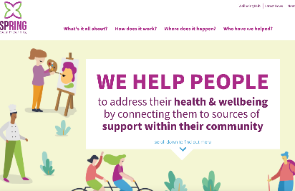
Spring Social Prescribing Project
CLICK
TO VIEW
ABOUT
SPRING Social Prescribing is active
in Northern Ireland and in Scotland. The service is available in 30 communities. SPRING Social Prescribing helps people to address their health & wellbeing
by connecting them to sources of
support within their community. As a result of SPRING Social Prescribing supports there has been a marked decrease in the number of GP visits made, ultimately taking the pressure of NHS services. SPRING Social Prescribing helps people aged 18+ to address their social, emotional, physical and practical issues.
For more information check out the website
https://www.springsp.org/
SUPPORTING SOCIAL INCLUSION
AND CONNECTION
SPRING Community support programmes and activities are to support those suffering from social isolation, low mood, mild depression, long term conditions or physical inactivity. They can include social clubs, arts & crafts, a phone helpline, peer support groups for those with long-term conditions, advice and guidance or volunteering groups. A total of 70 percent of referrals were made on behalf of people experiencing low mental health issues and social isolation.
SUPPORTING HEALTH, WELLBEING & NUTRITION
SPRING helps provide support for food, heating, shopping, social isolation, health issues such as Type 2 diabetes, digital exclusion and also refer those who are struggling into longer-term programmes such as a weekly food shop.
SUPPORTING GETTING ACTIVE TO KEEP WELL
With a support worker a health support plan is designed, one that identifies things would need and would like as an individual. This may be anything from joining an exercise class, or walking, cycling, fishing groups, yoga classes, or swimming lessons.
SUPPORTING ADULT LEARNING
There are education and learning supports contained within the support provided. SPRING empowers people to make decisions about their own health and learning opportunities and connects them to suitable programmes and services in the community
HOW IS THE ORGANISATION FUNDED?
Spring has secured funding from the National Lottery Community Fund, Northern Ireland Housing Executive and the Department for Agriculture, Environment & Rural Affairs
HOW DOES THE REFERRAL PROCESS WORK?
GPs, health professionals and pharmacists and
some non-statuary agencies refer patients.
https://youtu.be/UwlgfSz_CDw
OPPORTUNITIES FOR REPLICATION
Yes, these services and resources can be reproduced throughout the world. The world's first International Social Prescribing Day began in 2019.
MYTHS & FALSE BELIEFS
“There is a long waiting list”.
This is not true. SPRING has a quick turnover rate and contact potential service-users as quickly as possible.
“It’s the same as counselling”.
No, it’s different. Although social prescribing, like counselling, provides a safe space to talk and explore issues, SPRING link workers are able to support people in a more practical sense, as well as providing emotional care. A link worker can help sign-post participants to specialist counselling services.

Slide 36

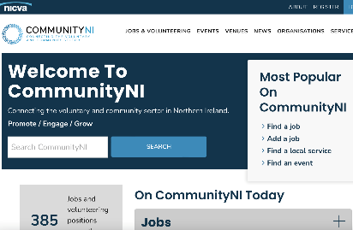
Connected Community Care Hub
CLICK
TO VIEW
ABOUT
The Connected Community Care Hub is operational in Belfast, with key Co-ordinators based in each area of the city. CCC HUB started taking referrals in Jan 2018 and was set up to develop a community centred approach to health and wellbeing by coordinating and connecting people to assets within their local area to meet their individual needs. This will increase people’s control over their own lives, supporting them to remain independent thus improving their overall health, wellbeing and social participation. We do not deliver services; however we connect individuals to existing services and support.
The service seeks to support persons aged over 18 and registered with a GP in the Belfast Trust area and meeting any of the following:
Individuals at high risk of developing a chronic condition
Individuals with an existing chronic condition(s) e.g., diabetes, stroke, COPD
Individual Older People who are socially isolated
Individuals with dementia (and their carers), including people waiting for an appointment at a memory clinic.
Individuals with a Cancer diagnosis.
https://www.communityni.org/organisation/connected-community-care
SUPPORTING SOCIAL INCLUSION
AND CONNECTION
By completing a comprehensive needs assessment addressing practical, social and emotional needs. Linking people in with supports in their local area and helping mobilise their personal, social, community and neighbourhood assets. We would link people in with services in the local community that would help alleviate exclusion, such as group session or 1-1 support.
SUPPORTING HEALTH,
WELLBEING & NUTRITION
We consider all the social determinants of health and helps identify any gaps in a person’s welfare. Any co-produced plan will have a positive impact on their overall health, with counselling, physical exercise groups, health, nutrition and pain management programmes such as those provided by our local community providers.
SUPPORTING GETTING ACTIVE TO KEEP WELL
We have access to the Healthwise programme which is a 12-week physical exercise programme targeting those with a sedentary lifestyle and a high BMI. There are also local walking groups, community gardens and local exercise groups which would include yoga and pilates etc.
SUPPORTING ADULT LEARNING
Linking people with local training and support projects. SIgnposting to the Recovery College and DfCs Condition Management Programme which enables individuals with difficulties to progress with education, learning and employment.
HOW IS THE ORGANISATION FUNDED?
Through the Local Commissioning Board
HOW DOES THE REFERRAL PROCESS WORK?
We receive referrals directly from GPs using their electronical referring gateway, Older Peoples Social Work Teams and a number of other teams from within Belfast Trust services.
OPPORTUNITIES FOR REPLICATION
This is a variation of a model used throughout the world
MYTHS & FALSE BELIEFS
“A pill will cure my ill”.
Whilst medication has a vital role in someone’s health, it is not the only remedy to improve a person’s health and wellbeing. The focus should be on prevention, early intervention, management and enablement.

Slide 37

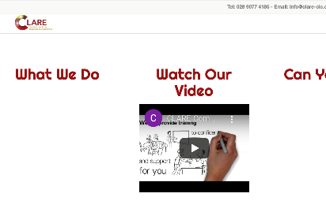
CLARE CIC
CLICK
TO VIEW
ABOUT
The vision of the CLARE [Creative Legal Action Responses & Engagement] is to create a community where all people feel supported and engaged, where people look out for one another and where everyone has the opportunity to reach their full potential.” CLARE is a community led voluntary organization working within North Belfast providing person-centred support to help engage with the most vulnerable to design and implement a holistic living plan. Service users are vulnerable adults and older people.
Objectives include the reduction of early reliance on adult health & social care services. Assists timely hospital discharge and support to return home. Helps to prevent deterioration in health outcomes and improve health and well-being. Empowers individuals to have ownership and greater control over the care and support services they receive. Promotes independence, choice and control through self-directed support. Provides help with practical tasks within the home and light housework. http://clare-cic.org
SUPPORTING SOCIAL INCLUSION
AND CONNECTION
Provision of Befriending service to reduce feelings of isolation and loneliness. Improves health & well-being and promotes independence by empowering individuals to shape and manage their care and support. Assistance to connect with existing social activities and draw on skills within local communities. Accompanies individuals to appointments and events.
SUPPORTING HEALTH, WELLBEING & NUTRITION
Through promotion of independence, choice and control through self-directed support. Support to access resources and services relevant to the individual’s needs such as support groups or activities to enhance physical or mental well-being. Opportunities to help with animals, walks and bowling.
SUPPORTING GETTING ACTIVE TO KEEP WELL
Connect with existing services relating to staying active and maintaining good health in order to achieve the best outcome for the person.
SUPPORTING ADULT LEARNING
Information and sign-posting to various courses/classes available.
HOW IS THE ORGANISATION FUNDED?
Belfast Health & Social Care Trust
Dormant Accounts Fund National Lottery Community Fund, Public Health Agency NI-CLEAR & Community Foundation Northern Ireland
HOW DOES THE REFERRAL PROCESS WORK?
CLARE works closely with Belfast Health & Social Care Trust Home from Hospital service and volunteer support.
OPPORTUNITIES FOR REPLICATION
There are many countries already delivering services to enhance the lives of adults and older people and to help maintain their independence and self-determination.
MYTHS & FALSE BELIEFS
“There’s no point trying anything new at my age”
“They won’t accept me because of my medical condition”
Both untrue: CLARE’s ethos is focused on ‘what a person can do and not on what they can’t’.

Slide 38

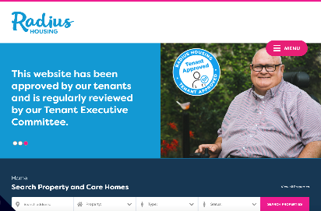
Radius Floating Support
CLICK
TO VIEW
ABOUT
RADIUS Floating Support is located in Northern Ireland. Coordinators offer a befriending service providing company and companionship, identifying needs, offer advice, sign-posting and help to access a broader range of services if required. It also helps family and friends belonging to the client, who may need a break from the responsibility of caring for their loved one. This service is available to Over 55s and/or vulnerable adults.
More information can be found on the following website: https://www.radiushousing.org
SUPPORTING SOCIAL INCLUSION
AND CONNECTION
Provides high quality outreach support, which includes daily contact via phone, regular home visits, helping individuals make connections with events and services, excursions and, in particular, with other people to enjoy the company of others and feel part of the local community.
SUPPORTING HEALTH, WELLBEING & NUTRITION
A tailored support plan for each service user to sustain and promote greater independence, good mental health, assisted shopping with the emphasis on healthy nutritional choices, weekly lunch clubs and meals- out.
SUPPORTING GETTING ACTIVE TO KEEP WELL
Provide social events such as walks, trips to forests/ beach/parks, and a weekly yoga session.
SUPPORTING ADULT LEARNING
Radius provides each service-user with a tablet, delivering one-to-one sessions with each person to explain how to use wi-fi and internet, access emails and other means of online communications. There is a book club and book rotation scheme, and craft and music sessions.
HOW IS THE ORGANISATION FUNDED?
Supporting People is a national framework for funding, planning, delivering and monitoring support services. Needs related support which seeks to enable vulnerable people to maintain and increase their resilience and independence as individuals, and capacity to be part of the community and society.
HOW DOES THE REFERRAL PROCESS WORK?
Referrals to the service come from Social Services, GPs, NIHE, Mental Health team or self-referral.
OPPORTUNITIES FOR REPLICATION
There are the similar support structures across different locations, this varies from country-to-country. Innovations and policy structure with emphasis on meeting housing and practical needs, as well as the emotional and psychological requirements of clients.
MYTHS & FALSE BELIEFS
“Radius only deals with housing.”
“You have to be elderly to get support from Radius.”
“Radius support is only provided through social services”
All are untrue:
Radius support workers specialize in mental health issues, emotional and psychological needs as well as housing issues, and there are new departments helping younger people and families. Radius will respond to all requests for help, and it does not have to be through professional intervention or referral.

Slide 39

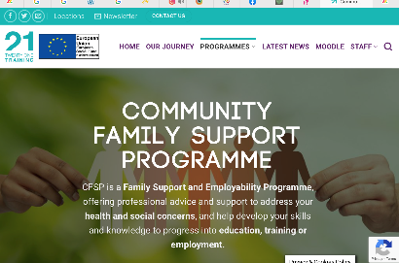
Community Family Support Project
CLICK
TO VIEW
ABOUT
The Community Family Support programmes is based in three councils areas of Northern Ireland:
Causeway Coast & Glens
Derry City & Strabane
Fermanagh & Omagh
The programme offers a range of supports including: Employment officers and career mentors providing Training, Work experience/trials, CV building, Team training and Employability skills. Family mentors offer support through Family Foundation and Focus on Family sessions and Resilience and Confidence workshops. Home visits and one-to-one session, as well as group courses and workshops.
The programme is open to all abilities/ gender /ethnicity/nationality of those aged between 16-65 years old. The programme has a particular focus on those who are unemployed or who struggle to find a satisfying permanent job; families experiencing difficulties or those feeling socially isolated. Website link:
https://21.training/community-family-support-programme
SUPPORTING SOCIAL INCLUSION
AND CONNECTION
Encouraging better relationships within families to improve parenting skills and assist in the development of self-confidence, motivation and social skills amongst participants. The programme will also expand the social circle and enable new opportunities and life options.
SUPPORTING HEALTH,
WELLBEING & NUTRITION
Supporting healthier life decisions, assisting with healthier nutritional food and lifestyle patterns. CFSP offers courses on better work/life balance, and mental health strategies, stress-management and healthy living advice.
SUPPORTING GETTING ACTIVE TO KEEP WELL
CFSP offers a OCN Level 1 in Sports & Leisure.
Employment and training can bring positive changes to an individual and their family.
SUPPORTING ADULT LEARNING
Customised Training Services include-Money management, access to grants and benefit advice. Help to find work or new employment opportunities. Accessing education and training opportunities. In addition, Level 1 accreditations are offered.
HOW IS THE ORGANISATION FUNDED?
This project is part funded through the Northern Ireland European Social Fund Programme 2014 - 2020 and the Department for the Economy.
HOW DOES THE REFERRAL PROCESS WORK?
Referrals can be made by GPs, Social Services, GPs, Recruitment Agencies, Mental Health Team or self-referral.
OPPORTUNITIES FOR REPLICATION
These services are provided in many countries across Europe, depending on the level of funding available.

Slide 40

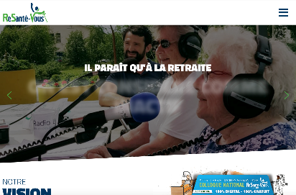
Re sante vous
CLICK
TO VIEW
ABOUT
ReSanté-Vous is based in France, in Bordeaux. It’s a partnership of the Pole Culture & Santé. The project works to improve the living conditions of the elderly and contribute to their well-being.
This organisation provides supports both for old people and for care staff working of older people. According to the website, three hundred and thirty-three medical and social structures are involved in the project. The C & A cluster is also co-leading a training course with this company.
For more information go to
https://www.resantevous.fr/
SUPPORTING SOCIAL INCLUSION
AND CONNECTION
This example of social prescribing promotes connectivity through activities which encourage relationships.
For example, in recent years they have participated in a radio show between teenagers and people in nursing homes. Another example is that "Resanté-vous" regularly offers training to create human relationships between caregivers working with the elderly.
SUPPORTING ADULT EDUCATION.
This organisation promotes adult education for both carers and the elderly. It provides carers with resources on humane care. For older adults, it provides a range of trainings including topics like art and sports. The organisation also creates community education opportunities, for example by promoting intergenerational projects between school children and older adults.
SUPPORTING GETTING
ACTIVE TO KEEP WELL
This social prescription makes it possible to maintain good health through all the activities proposed in retirement homes or other structures welcoming elderly people. The organisation also supports the health of health professionals through giving them better training and support.
HOW DOES THE REFERRAL PROCESS WORK?
“Resanté-vous” has developed partnerships with retirement homes. This organization has also developed a network to share their values and present their training.
MYTHS & FALSE BELIEFS
“Old people don't concern me, I'm young”
It’s false! Old age is a subject common to us all. And we can all learn about the conditions and about possible innovations, moving away from myths.
GOOD HEALTH IN OLD AGE, THROUGH INCLUSION, EDUCATION, AND CONNECTION.

Slide 41

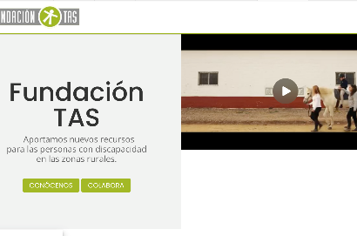
Fundación TAS
CLICK
TO VIEW
ABOUT
Fundación TAS (the TAS foundation) is based in Brenes (Seville) – Spain. They provide support for people with disabilities and for older adults, to participate in the workforce in a way which accommodates their disabilities and works for them. Through its Labour Insertion service, these people are individually guided and accompanied in their social and work adaptation and in their transition to a job in a normalized company or in the Foundation's Special Employment Centre.
In this Special Employment Centre, the participants make a “controlled immersion” in a real work environment, where the objective is that, as workers, these people carry out productive and remunerated work, obviously, according to their personal characteristics.
For more information go to https://www.fundaciontas.org
SUPPORTING SOCIAL INCLUSION
AND CONNECTION
Fundación TAS programs promote participation in group activities and, therefore, interaction and the creation of interpersonal bonds. For older adults and for adults with disabilities, sharing time and work with other people, for example in occupational workshops can be a good way to have new life goals and create new relationships with other people. Adults of working age who, due to accident, illness, etc., have been removed from their working life, can be socially isolated and may lose confidence to reintegrate into their social life and in the job market by themselves. Fundación TAS supports these people to access a supportive and social work environment.
SUPPORTING GETTING ACTIVE TO KEEP WELL
Fundación TAS programs interrupt the personal isolation processes. Isolation can lead to neglect of diet and physical condition, as well as mental health problems such as depression. All these programs involve physical exercise, both specific to the activities proper and linked to complementary activities organized by the Foundation, which has a Leisure and Personal Autonomy Program.
SUPPORTING ADULT LEARNING
Adult Learning is a fundamental part of the work carried out from this integrated set of resources for employment. Fundación TAS conducts Occupational Workshop from a pre-employment perspective and in the Special Employment Centre with a direct focus on the labour market.
HOW IS THE ORGANISATION FUNDED?
Through contributions from public entities (City Councils and Andalusian Government), patronage, beneficiaries, social works of some banks, micro donors (individuals and companies), brotherhoods, etc. Approximately 67% is public financing and 33% private.
HOW DOES THE REFERRAL PROCESS WORK?
Foundation's technical staff (psychologists, therapists, etc.) refer people who can potentially fit into pre-employment or employment activities, coordinating its labour with the staff responsible for the different employment services.
SOCIAL PRESCRIPTION FOR PEOPLE WITH DISABILITIES THROUGH COLLABORATIVE WORK

Slide 42
06
MENTAL HEALTH
33
The Seany Project
34
Havin a Laugh Charity
35
Intervention in the Community- for socially isolated older & disabled people

Slide 43
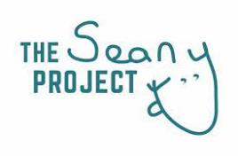
The Seany Project
CLICK
TO VIEW
ABOUT
The Seany Project is based in Ireland.
It is a wellbeing sports based social enterprise aimed at getting men, women and young adults talking about their mental health. Using their uniquely designed ‘thoughtball’ a friendly 5 questioned approach written on the ball that you answer and pass around the circle. It can be used in Schools, GAA clubs, Soccer Clubs, Residential Care, Youth Centres, or anywhere. The Seany Project believe all members of society should have equal access to mental health and wellbeing supports.
For more information go to
http://theseanyproject.com/
SUPPORTING SOCIAL INCLUSION
AND CONNECTION
The Seany Project aims to start conversations in groups, primarily sports groups, but could be used in any environment. With the use of the ‘thoughtball’ connections can be made and conversations can be had.
SUPPORTING GETTING ACTIVE TO KEEP WELL
The Seany Project has visited sports groups, which encourage people to get active as a way to mind their mental health and keep well.
HOW IS THE ORGANISATION FUNDED?
The First Fortnight mental health charity funded the social media video and website. The Seany Project sell Mental Health Repair Kits; the well-being kits include.
training top
kit bag (secret pocket for phone and mask)
thoughtball .
If a school/ club/ organisation works with the project they pay directly.
HOW DOES THE REFERRAL PROCESS WORK?
Groups or individuals can contact The Seany Project directly.
OPPORTUNITIES FOR REPLICATION
The Seany Project would be able to be replicated in other countries using the ‘thoughtball’. The ball has several different words and phrases which encourage people to start a conversation.
MYTHS & FALSE BELIEFS
‘I’m not in a sports club, so I can’t be part of The Seany Project’.
The Seany project is open to anyone or any group to join. It encourages open conversations within group environments.
PRESCRIBING SPORTS FOR MENTAL HEALTH, CREATING OPEN CONVERSATIONS.

Slide 44

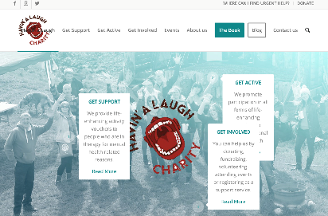
Havin a Laugh Charity
CLICK
TO VIEW
ABOUT
Havin’ALaugh is based in Sligo, Ireland. They promote positive mental health through life-enhancing activities. Havin’ a Laugh gives life-enhancing activity vouchers to people in mental health recovery, providing people with the opportunity to re-engage with activities they love, and through these social connections maybe start their own healing conversations. They also create awareness events for the general public that showcase the life-enhancing activities available in their locality.
For more information go to
https://www.havinalaugh.com/
SUPPORTING SOCIAL INCLUSION
AND CONNECTION
Havin’ a Laugh focus on social inclusion in all their activities and they encourage people to become connected. It could be through the monthly coffee mornings, or another event hosted by the charity.
SUPPORTING GETTING ACTIVE TO KEEP WELL
Havin’ a Laugh believe that exercising, getting outdoors and taking part in community-based activities are all essential to our mental health, and one of our main objectives is to make life-enhancing activities easily accessible to people who are in therapy for mental health reasons.
HOW IS THE ORGANISATION FUNDED?
The organisation is funded through donations, fund raising events, and occasional grants.
HOW DOES THE REFERRAL PROCESS WORK?
Registered support services refer clients to the charity.
OPPORTUNITIES FOR REPLICATION
A similar system could be replicated in other countries with service providers.
MYTHS & FALSE BELIEFS
Myth
“I can’t use Havin’ a Laugh vouchers because I don’t have the energy to get active.”
Havin’ a Laugh will look at the activity you are interested in. It could be art, or even a relaxation class.
PRESCRIBING LIFE-ENHANCING ACTIVITIES FOR MENTAL HEALTH RECOVERY

Slide 45
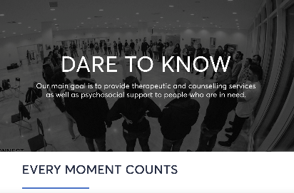


Intervention in the Community for socially isolated older & disabled people
CLICK
TO VIEW
ABOUT
Intervention in the Community is based in Athens, Greece. IASIS NGO developed the service in March 2020, in response to the COVID-19 pandemic. This program supports the elderly and other people with disabilities who are not able to move easily, providing them with basic support services.
For more information go to https://www.iasismed.eu/?lang=en
SUPPORTING SOCIAL INCLUSION
AND CONNECTION
The services provided by the program are aimed at psychosocial support; companionship / Entertainment / Creative employment; and facilitating digital governance issues, intangible prescription. These all provide social inclusion opportunities and improve service users’ ability to connect with their community.
SUPPORTING HEALTH, WELLBEING & NUTRITION
The programme supports people in meeting daily needs like accessing food when medical vulnerabilities and mobility issues make these things difficult. It also provides practical wellbeing support, for example, with personal care and hygiene; support in the organization and cleaning of living spaces.
SUPPORTING ADULT LEARNING
Intervention in the Community provides self-care training to promote autonomous living in those who struggle with it.
HOW IS THE ORGANISATION FUNDED?
By IASIS NGO and the Ministry of Health.
HOW DOES THE REFERRAL PROCESS WORK?
Psychologists at a referring hospital work with the organisation to develop individualised treatment plans for people who would be suitable. Psychoeducation training run at the hospital help make staff there aware of the programme.
OPPORTUNITIES FOR REPLICATION
This could be replicated anywhere by organisations who work in mental health.
COMMUNITTY, COMPANIONSHIP, CREATIVITY: WHILE MEETING THE NEEDS OF VULNERABLE ADULTS

Slide 46
www.socialprescribers.eu

